Slide 1
IMPAWATT AND ESI Europe
Presentation of the project and the results
March 9, 2021

Slide 2
Partners IMPAWATT Project
AUSTRIA : AEA – Austrian Energy Agency
FINLAND : VTT - Technical Research Centre of Finland
FRANCE : CCI Auvergne Rhône-Alpes – Regional Chamber of Commerce
GERMANY : SEnerCon - Engineering and consultancy in the field of supporting households to save energy
ITALY : Environment Park - Parco ScientificoTechnologico per l’Ambiente
SWITZERLAND : PLANAIR – Lead PARTNER - Consulting engineers in energy and environment

Slide 3
Program
Welcome: Michel Beyet, CCI Auvergne Rhône Alpes
IMPAWATT Project presentation: Yannick Riesen, PLANAIR
IMPAWATT Platform presentation, main features: Claudia Julius, SENERCON
IMPAWATT Energy efficiency information available on the platform: Konstantin Kulturer, AUSTRIAN ENERGY AGENCY
IMPAWATT Energy culture and sustanaible supply chain: Sirje Vares & Zarrin Fatima, VTT
IMPAWATT Overview of the project activities made with the companies to overcome barriers: Luca Galeasso, ENVIPARK
Presentation of another H2020 efficiency project : ESI Europe, Livia Miethke Morais, BASE
Discussion/exchange and conclusion: Yannick Riesen, PLANAIR
Conclusion: Daniel Schaller/Yannick Riesen, PLA/EASME

Slide 4



Project introduction
IMPlementAtion Work and Actions To change the energy culTure
Yannick Riesen
SWITZERLAND
The sole responsibility for the content of this publication lies with the IMPAWATT project consortium. It does not necessarily reflect the opinion of the European Union. Neither EASME nor the European Commission are responsible for any use that may be made of the information contained therein.

Slide 5
H2020 Call
Over all Goal
Increase energy efficiency in Industry and services (e.g. Ensure that energy audit recommendations lead to actual implementation)
TOPIC
Increasing capacities for actual implementation of energy efficiency measures in industry and services
Tool:
Staff trainings and capacity building programs
All actors should be targeted.
for
Energy efficiency
Enhance corporate policy towards
Energy culture
Sustainable supply

Slide 6


Barriers
Barriers to energy efficiency investments
More details in the Luca’s presentation
Even companies with energy audits recommendations are only partially implemented (4% to 20 % are implemented^{1,2})
Lack of internal ressource
Lack of technical knowledge
Lack of time
1 A Study on Energy Efficiency in Enterprises: Energy Audits and Energy Management Systems, EU, April 2016
2 EMEEES bottom-up case application 18: Energy Audits, Report, L. Gynther and U. Suomi
3 Köwener Dirk, Nabitz Lisa, Mielicke Ursula and Idrissova Farikha, Learning Energy Efficiency Networks for companies: Saving potentials, realization and dissemination, eceee Industrial Sumer Study proceedings, 1-065-14, pp. 91-100, 2014.

Slide 7
IMPAWATT
OBJECTIVE : Increase the implementation of the energy efficiency investments and measures in industry
HOW ? Through the development of an online capacity and staff building program

Slide 8
Why IMPAWATT?
In industrial and service sectors, energy efficiency investments are often not implemented due to a combination of factors and barriers faced by the actor involved : lack of time, internal resources, knowledge …
IMPAWATT is identifying and addressing these barriers.
Impawatt aims at creating a staff training and capacity building platform to enhance corporate policy towards energy efficiency, energy culture and sustainable supply-chain initiatives.

Slide 9
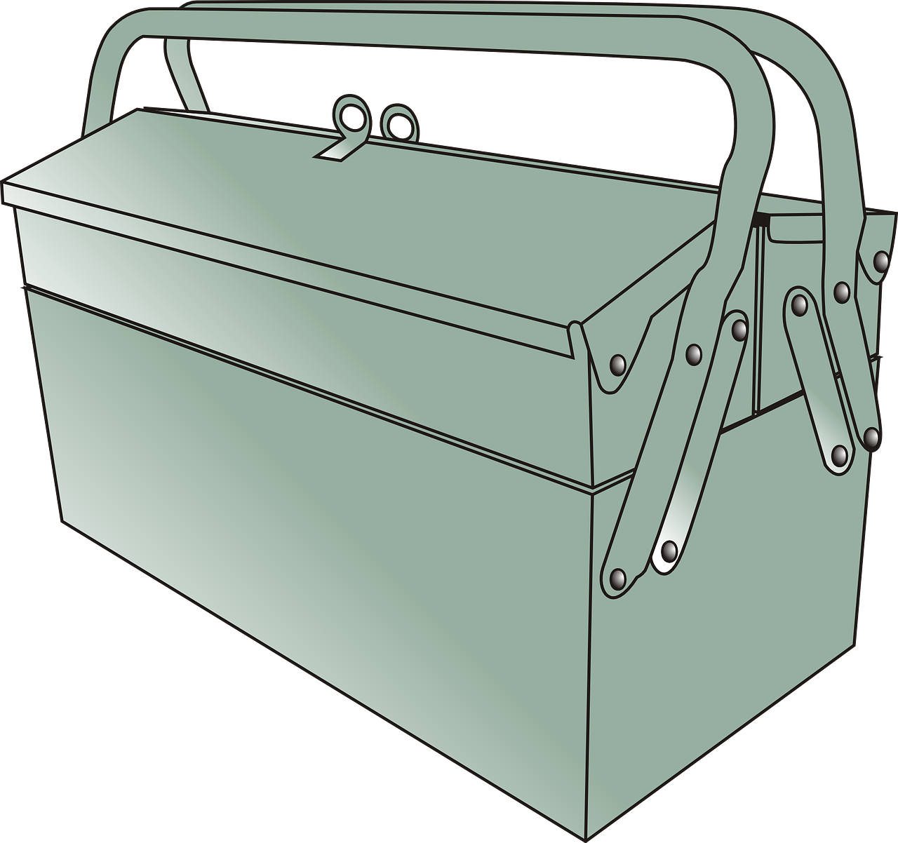
Toolbox

Slide 10





Platform architecture
 Resources
 Tools
 User restricted area
 Teaching and informations
  Knowledge tests
 Content is classed and can be filtered
 Measures DB
 User
Description (link to webinar…)
Energy saving calculation (tool)
Return time statistics
Number of implementations
Comments and rating…
Role
White labelled
presentations
 Company/Site
Tailored content
Webinars
  Incentives DB
Country and Sector
# employees
Energy reference area
Building age
Main Equipment (Compressed air, Vacuum, CVS,….)
Factsheets
financial and non financial
 Energy behavior survey
 Monitoring
Testimonials
 LCA
 Link to energy monitoring system Energy Savings Account (iESA).
Topics: Energy efficiency, energy culture, sustainable supply chains
⬅  Measures management
  Peer to peer exchange
 Content can be rated and commented.
 Webinars and forum
 Benchmarking
Proposed and implement measures

Slide 11



How is IMPAWATT used
IMPAWATT Platform
Web based platform (staff training and capacity building resources)
“Mr Energy” (Energy manager, board member, auditor,..)
directly
through
directly
through
directly
through
directly
through
Incentives (financial, image, other)
Benchmark with other similar companies
Benefits
Energy culture
How to choose new/replacement equipment regarding energy effficiency
Sustainable supply-chain
LCA
HVAC
Pumps
Sub-metering
Process Control
Lamps
Building envelope
Best practice
Energy efficient production
Energy efficient behavior
Decision makers
Purchase department
Technical staff
Production staff

Slide 12


Information level
Superficial information found on the internet
Time consuming trainings (complete courses)
IMPAWATT fill the gap

Slide 13





IMPAWATT Workflow and project concept
WP1
Barriers mapping and best practices
Creation of platform content
Online
Platform
WP6
Testing and assessment
WP2
Capacity Building for Energy Efficiency
○ Platform presentation
 Testing
 Assess impact
 Collect best practice and methodology
 platform concept and design
WP3
Capacity Building for energy culture

WP4
Capacity Building for sustainable supply chain
40+
presentation
80+ DB entries
EE measures
WP7
Dissemination and exploitation
6 x 10+
webinars
100+ Factsheets


○
6 x 10+
Testimonials

Tests and
surveys
WP5
Development of the platform 

Slide 14
Deploy and test WP6

Slide 15

Platform presentation, main functions
Claudia Julius
GERMANY

Slide 16

Impawatt at a glance
Web platform in 6 countries (Austria, Switzerland, France, Italy, Finland, Germany) and 5 languages
Use is free of charge for companies
Topic: Energy and sustainability
Industry and service sector
Content : Pre-selection for each company that registers, according to sector and branch
Content: Factsheets, presentations, checklists, calculation tools, quizzes, surveys, webinars
Monitoring area: Energy consumption and implemented measures

Slide 17
Target group
The platform is primarily aimed at the company's energy manager, Mr. or Ms. Energy, but also at employees and external energy consultants.
She/he can find useful materials on the platform to
  Implement recommendations on energy efficiency
  Monitor energy consumption
  Increase the skills and motivation of staff in different departments: purchasing, maintenance, production staff, human resources, communication, ...

Slide 18








Topics and Content
Energy efficiency
Energy culture
Sustainable supply chain
Energy management
Plants (pumps, motors, valves)
Building heating and cooling
Lighting systems
Process heat
Mobility
Renewable energies
How can companies motivate their employees and bring about a lasting change in behaviour towards energy efficiency ?
Life cycle analysis
Guidelines for life cycle costs
Use of sustainability indicators
Environmental labelling

Slide 19

Content
Numerous and varied content on two main areas :
Secure personal area: company data, monitoring
Content area with 218 different elements:
    - 74 Descriptions of measures
    - 43 Best Practice Factsheets
    - 30 Checklists and calculation tools
    - 3 Surveys for employees and energy managers
    - 15 quizzes
    - 43 White label presentations
            - 10 webinars
customised content from the general area:
Evaluation of the content and
Comment function

Slide 20
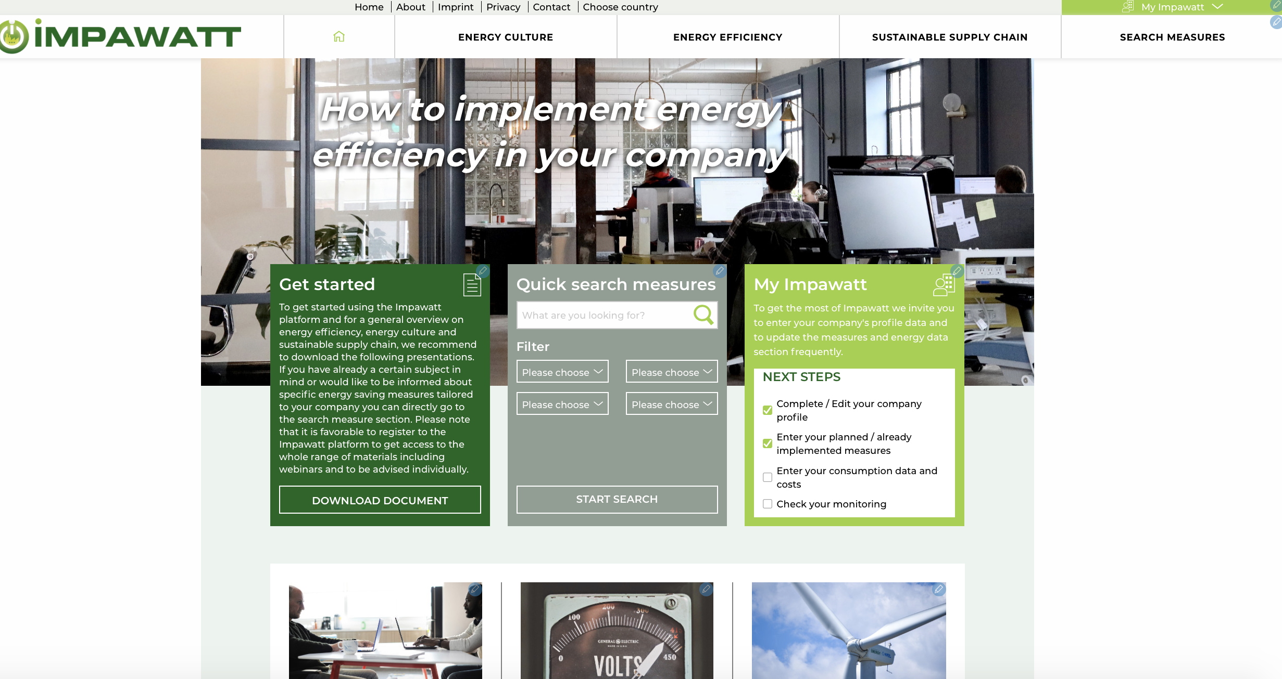
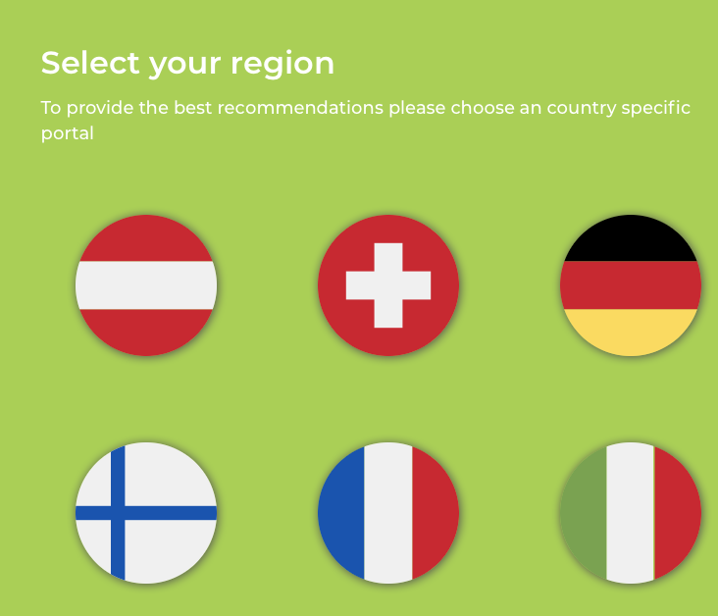
Landing page
European page https://eu.impawatt.com
National subpages with different languages, e.g., https://ch.impawatt.com

Slide 21
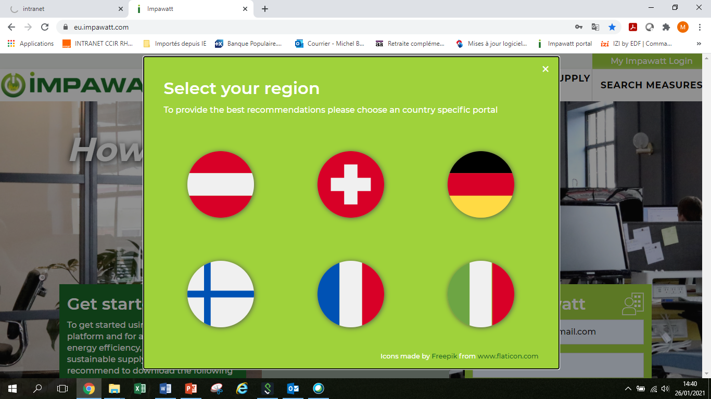
A platform available in 6 national versions and in English
AUSTRIA
GERMANY
FRANCE
ITALY
SWITZERLAND
FINLAND
European version
in english

Slide 22
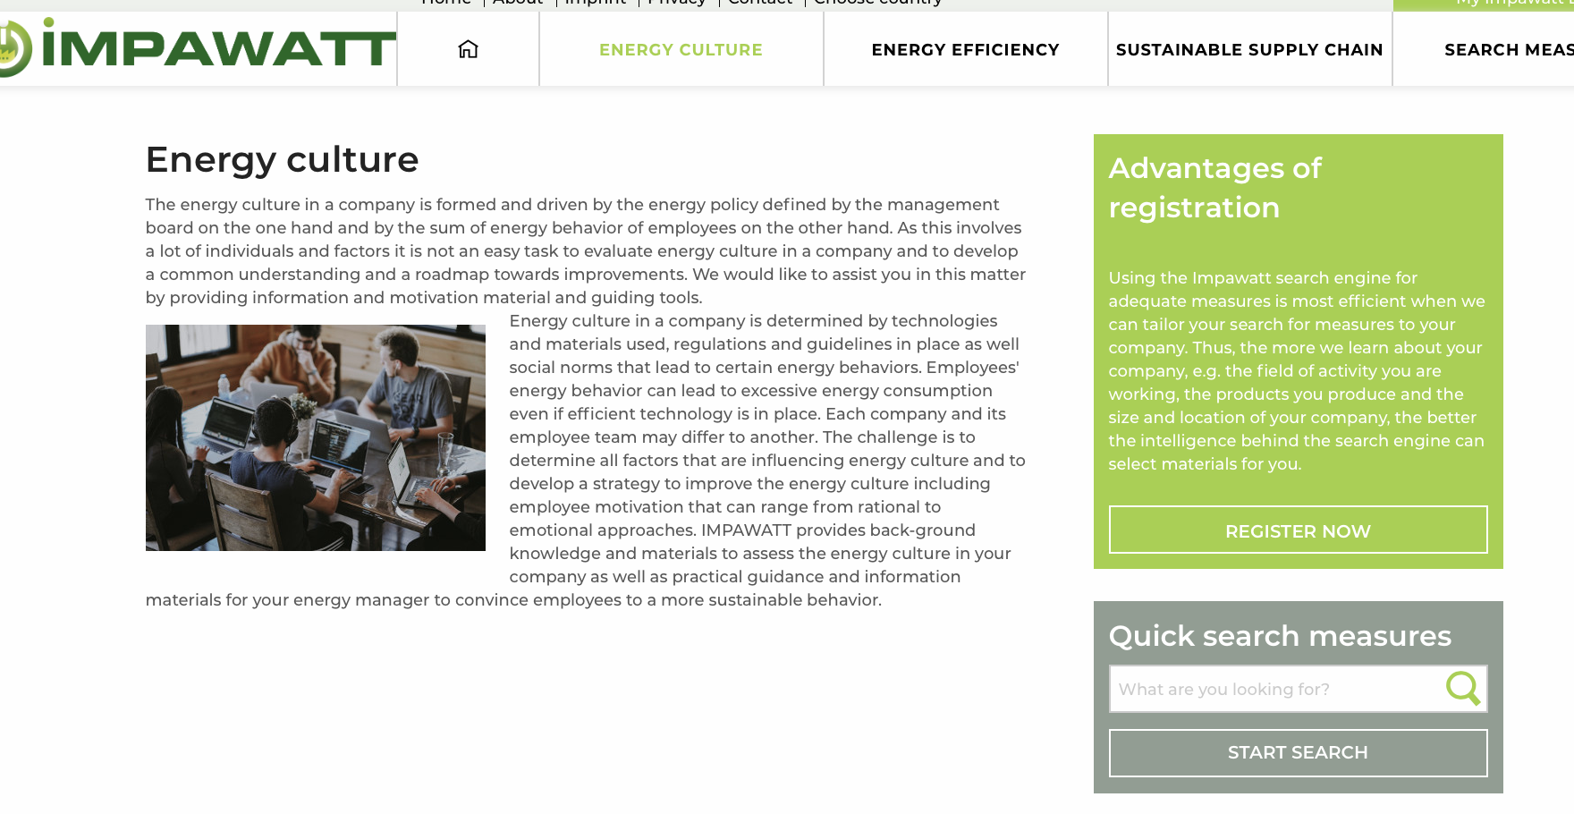
Main navigation
General information on the three main pillars of the platform
Access to search measures engine from main navigation and on each pillar’s page

Slide 23
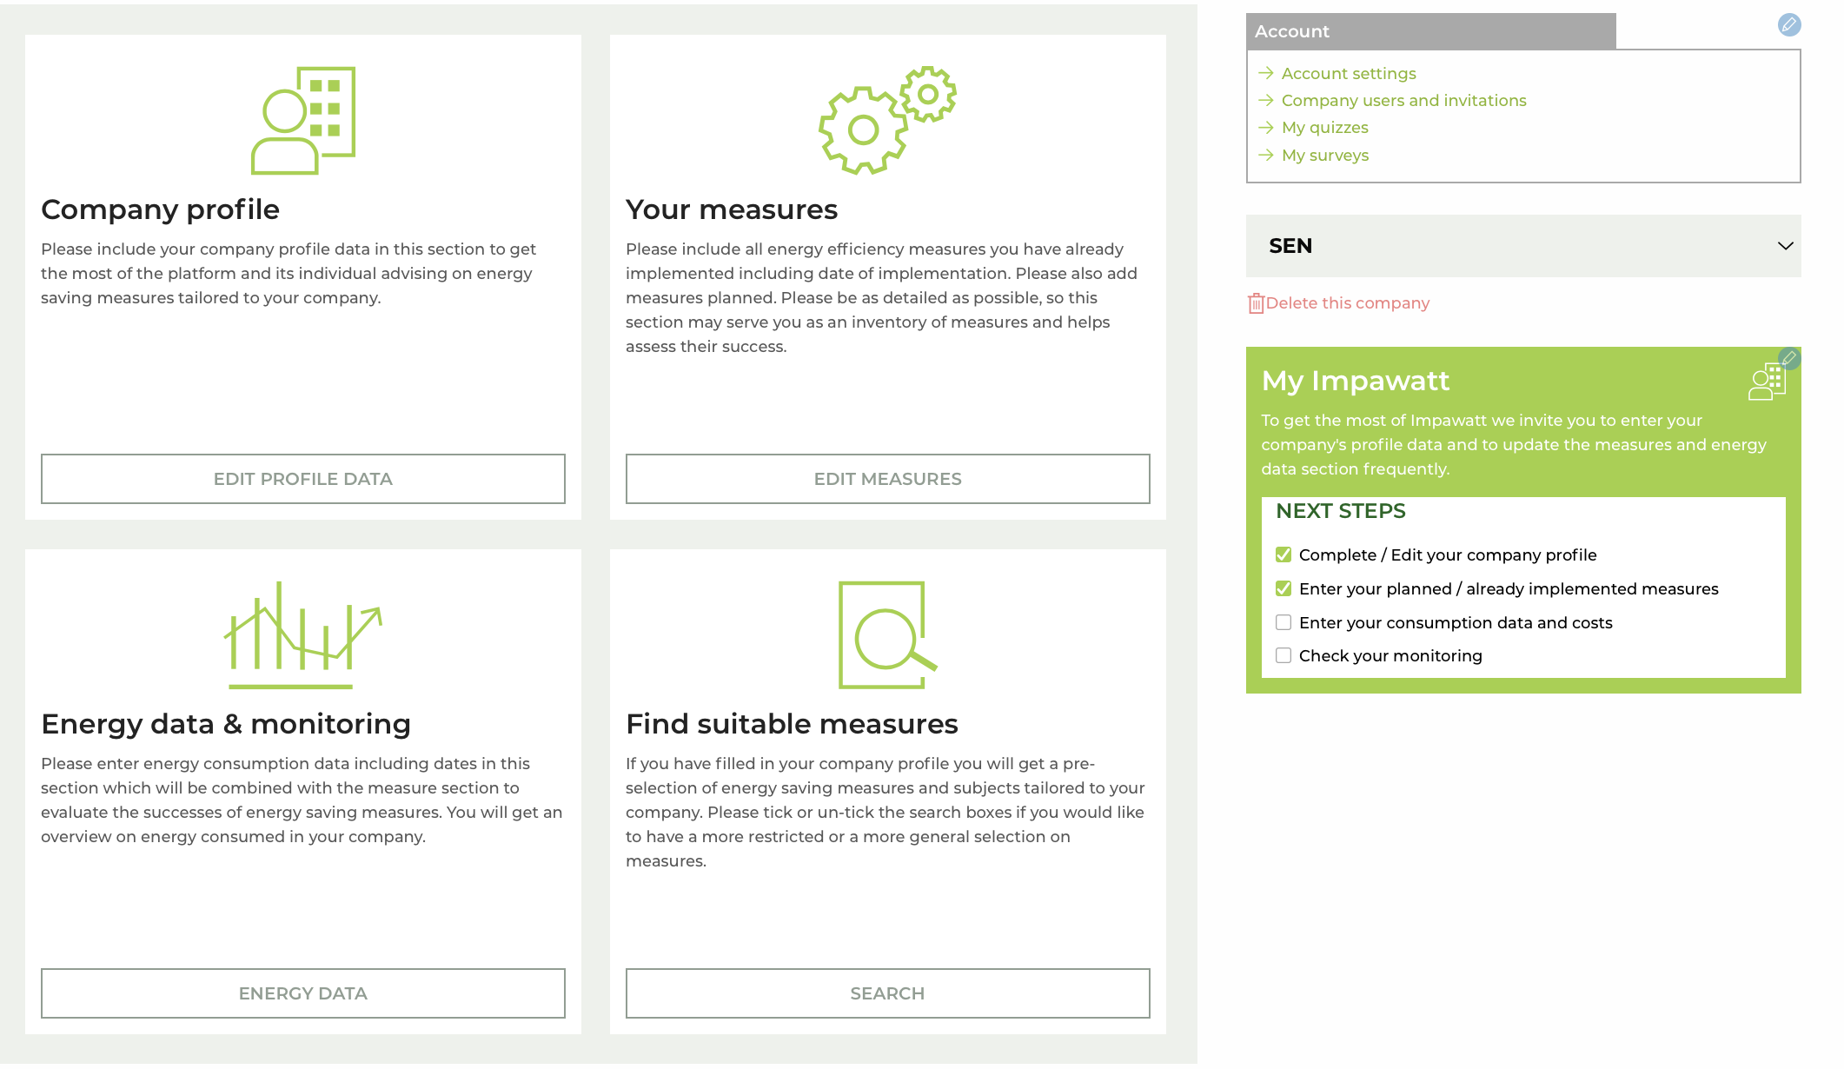
Main navigation and Dashboard
Access to the dashboard with personalized data
Overview on company’s activities and settings

Slide 24
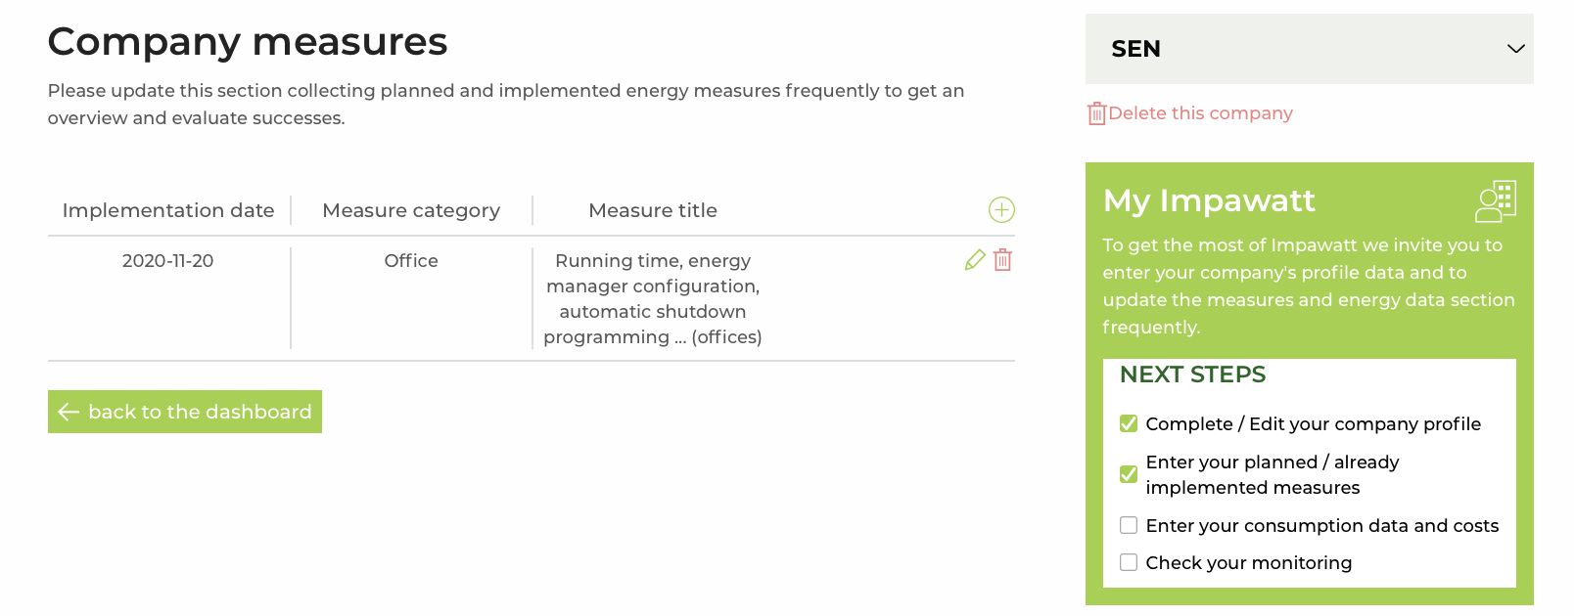
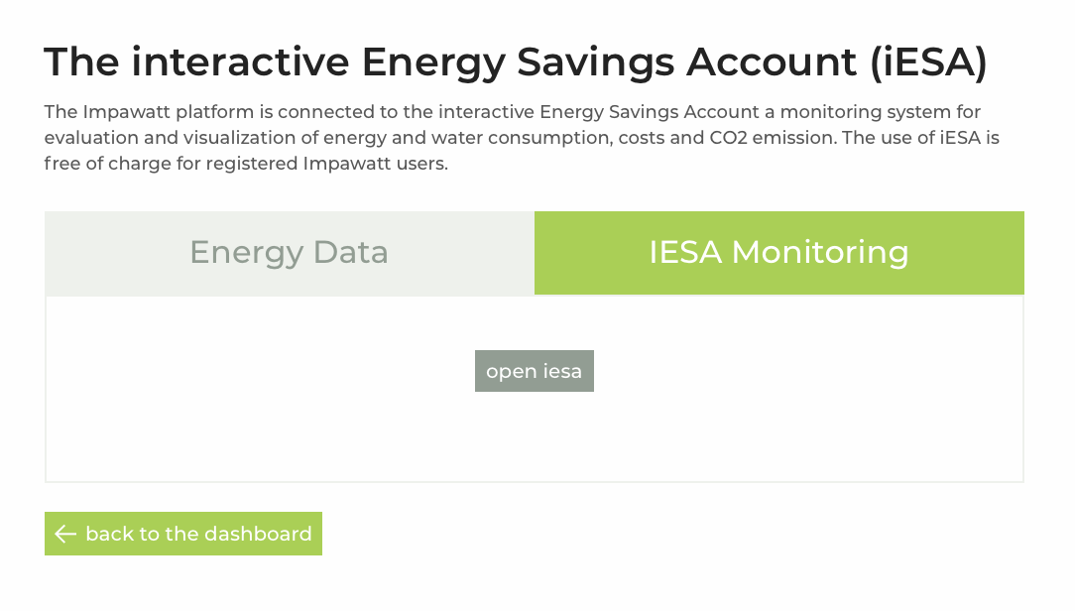
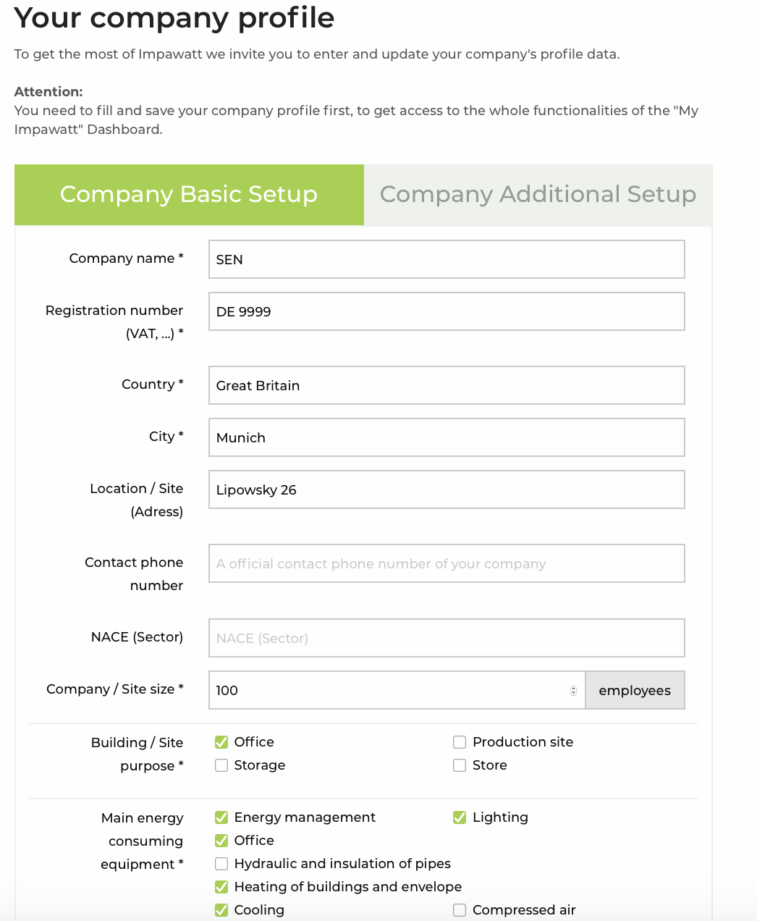
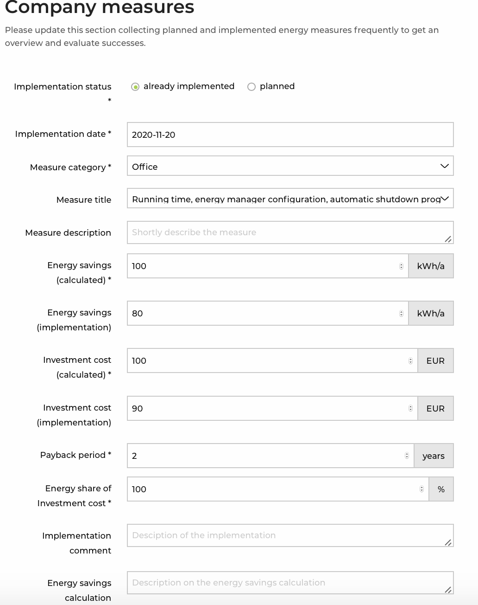
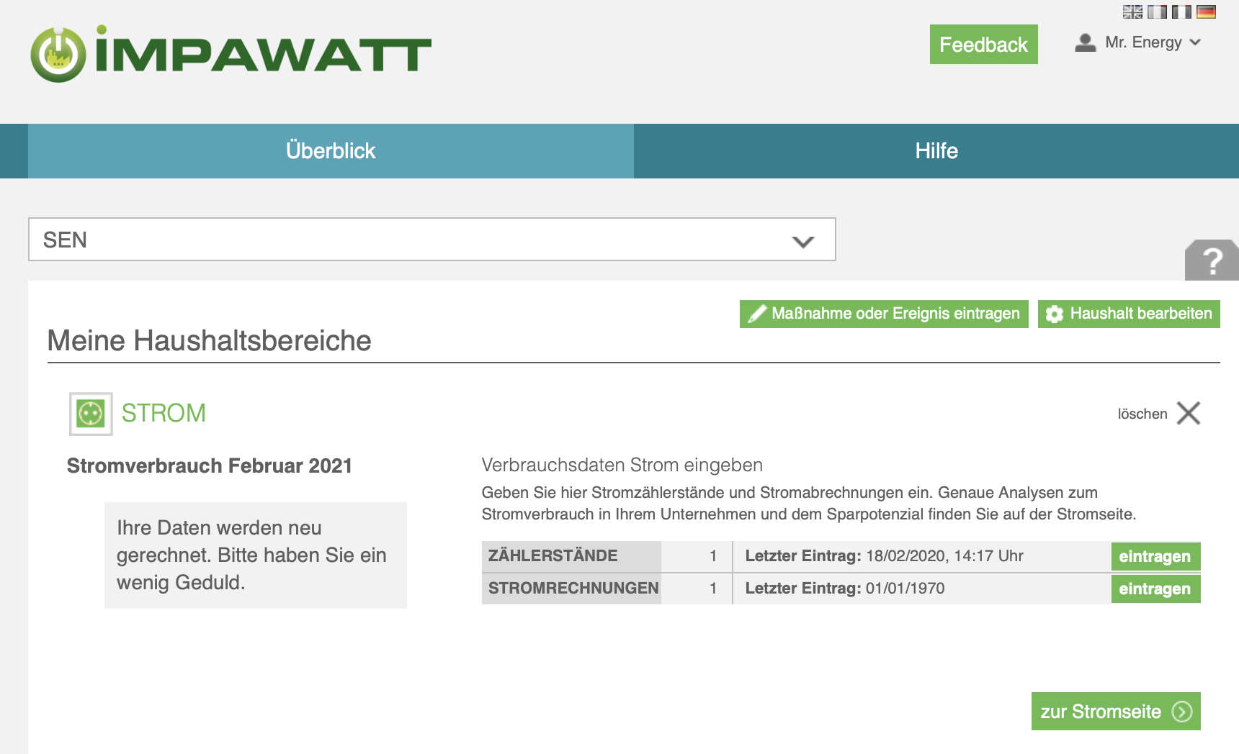
Company Profile Data and Monitoring

Slide 25
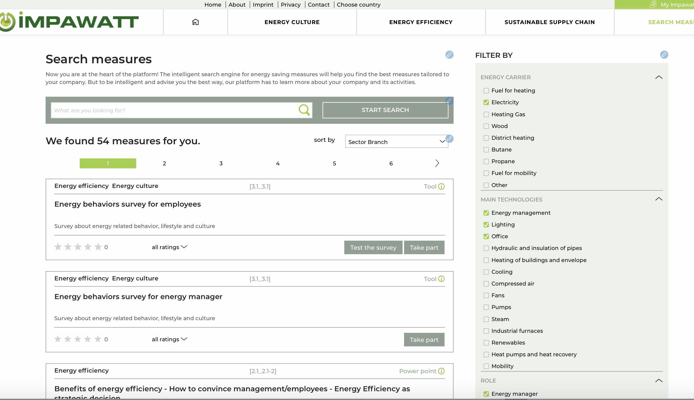
Search Measures Engine
Filtering criteria:
Energy carrier
Main technologies
Role
Sector/Branch
Content theme
Content type
Pre-selection according to company’s profile that can be changed.

Slide 26
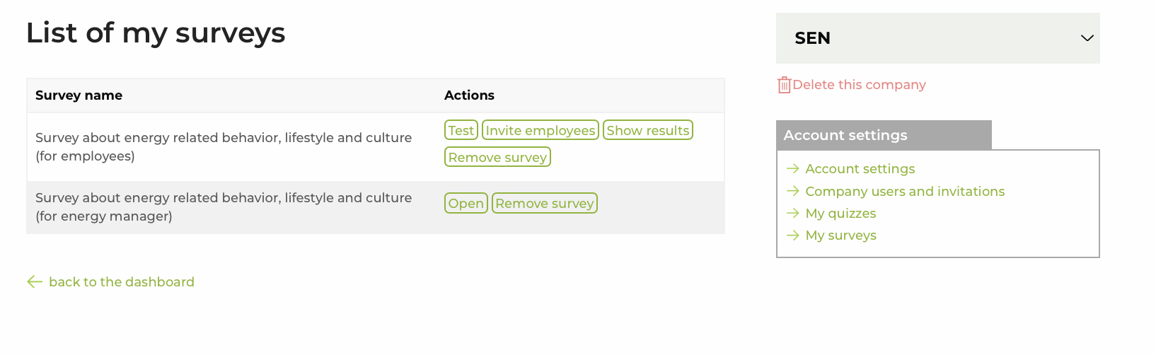
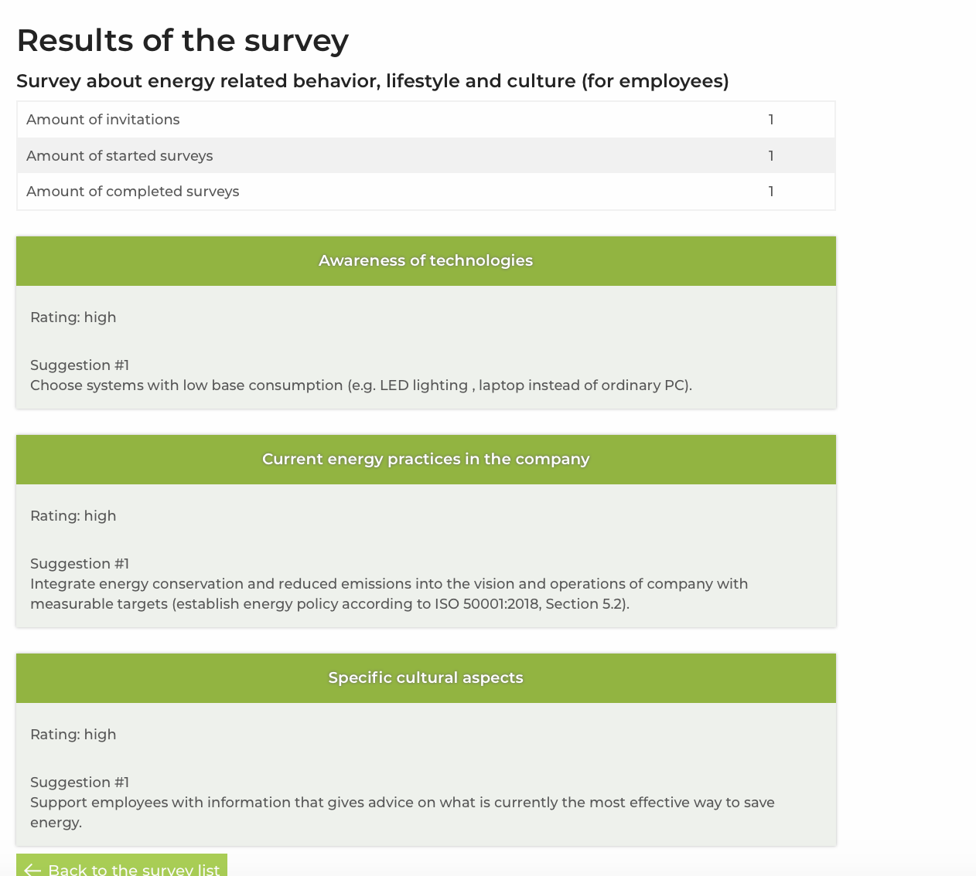
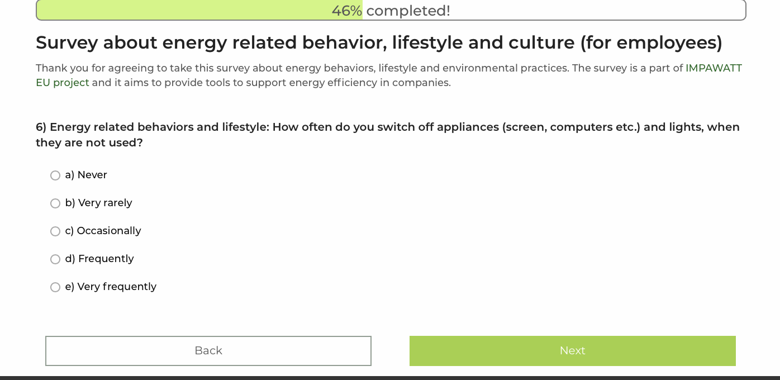
Behavioral Suveys for Mr. Energy and Employees
Content elements,
can be searched by the keyword survey in the search engine
Once the user clicks Take part, the survey appears in the My Impawatt section My Surveys
Results: Recommendations regarding technologies, awareness and cultural aspects

Slide 27
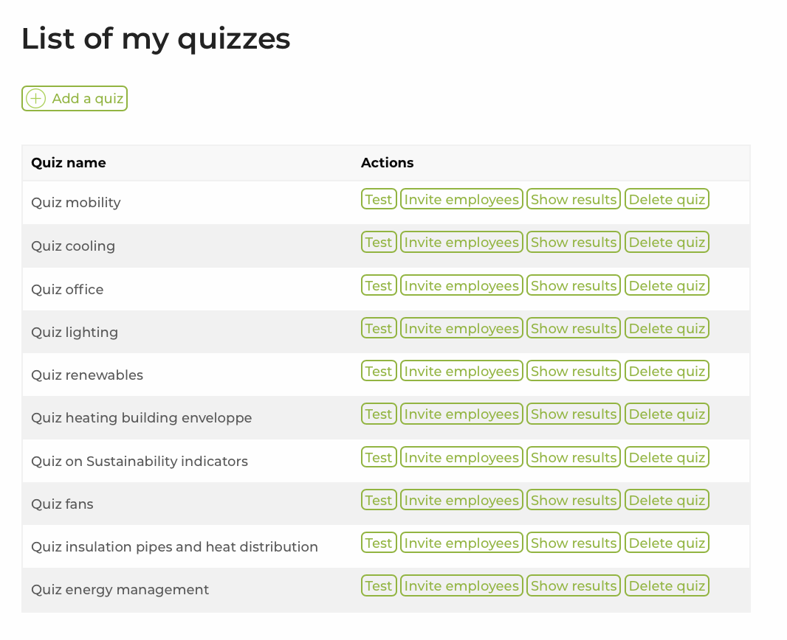
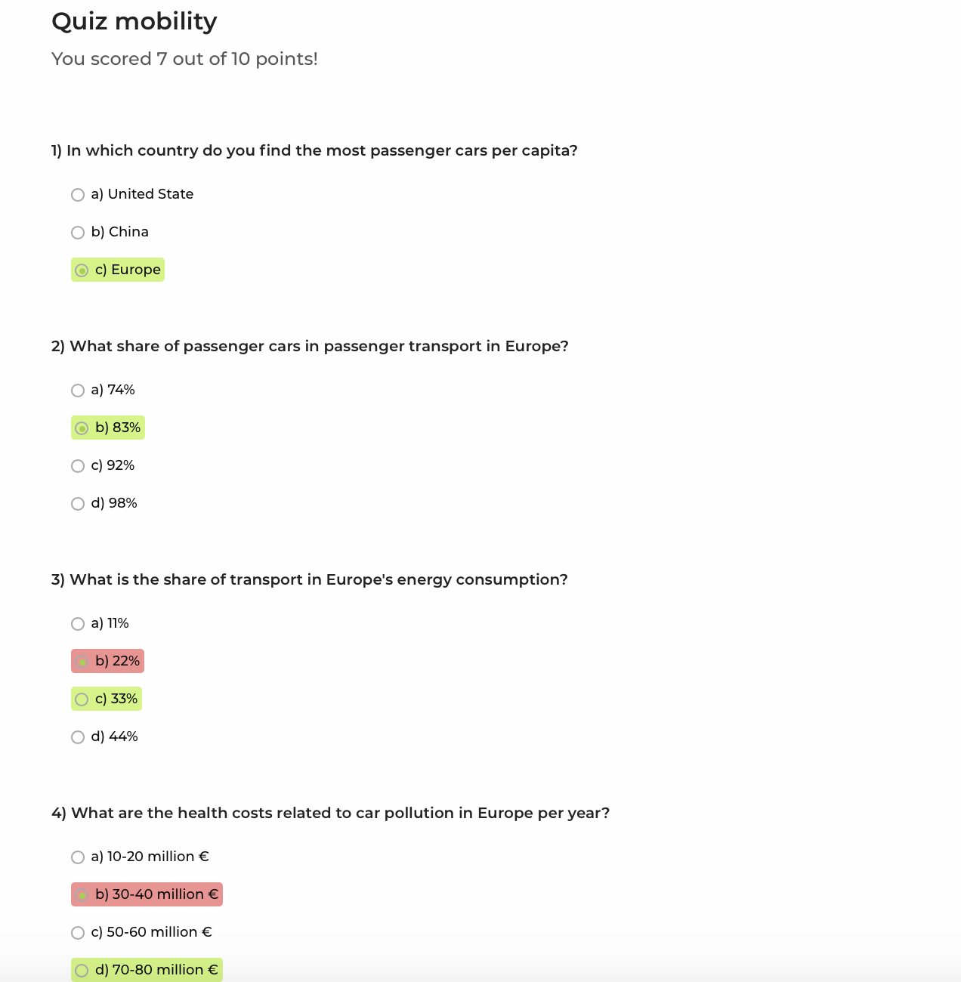
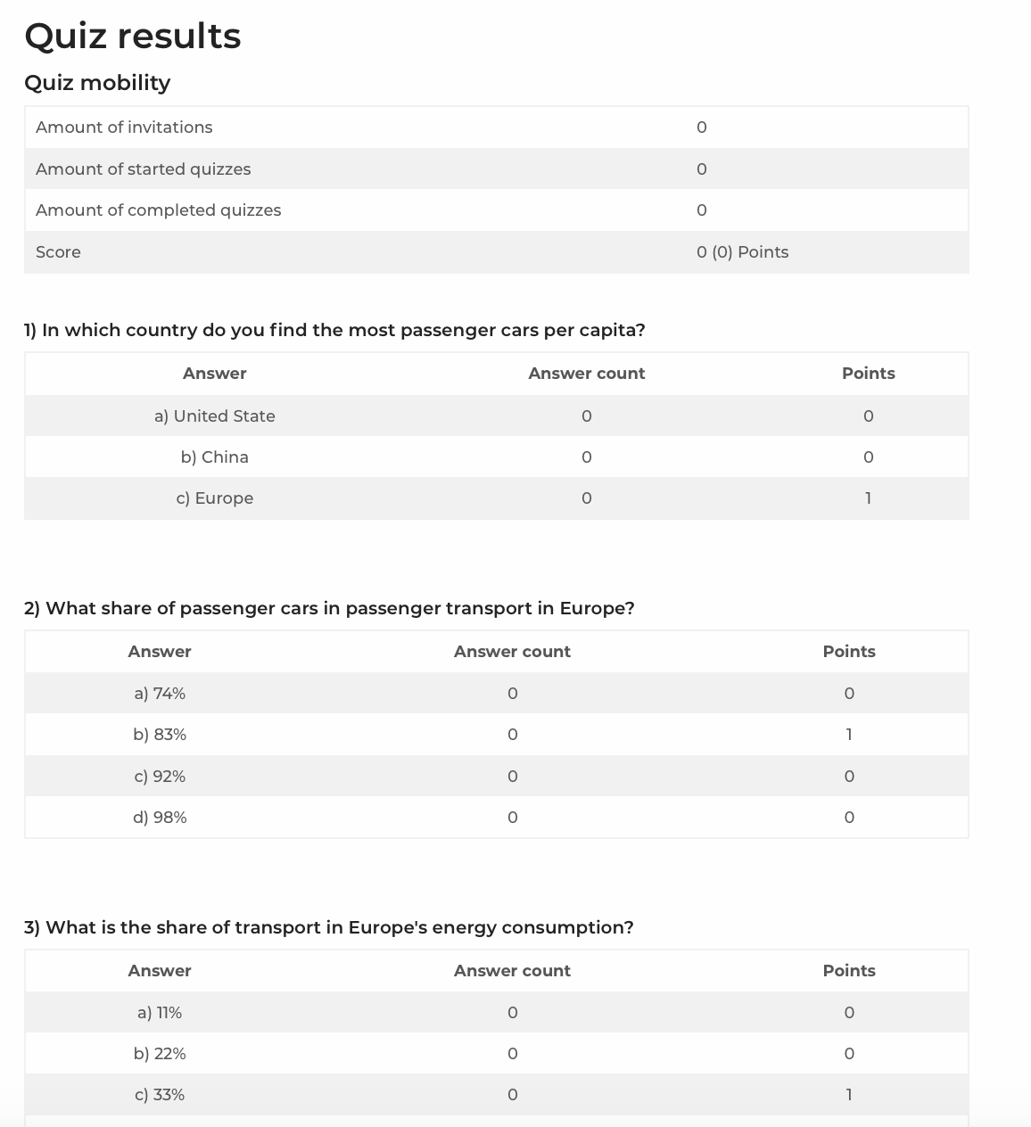
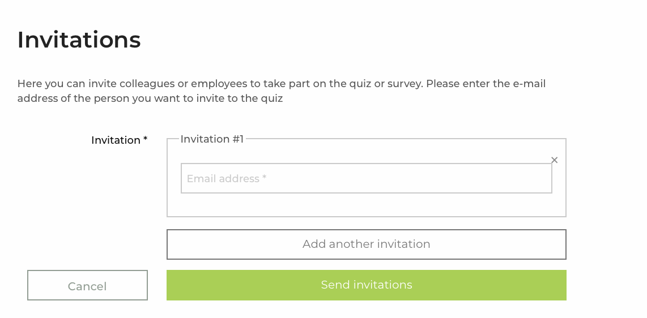
Quiz Section
Content elements,
Stored in the My Impawatt section under My Quizzes
Employees can be invited to participate

Slide 28
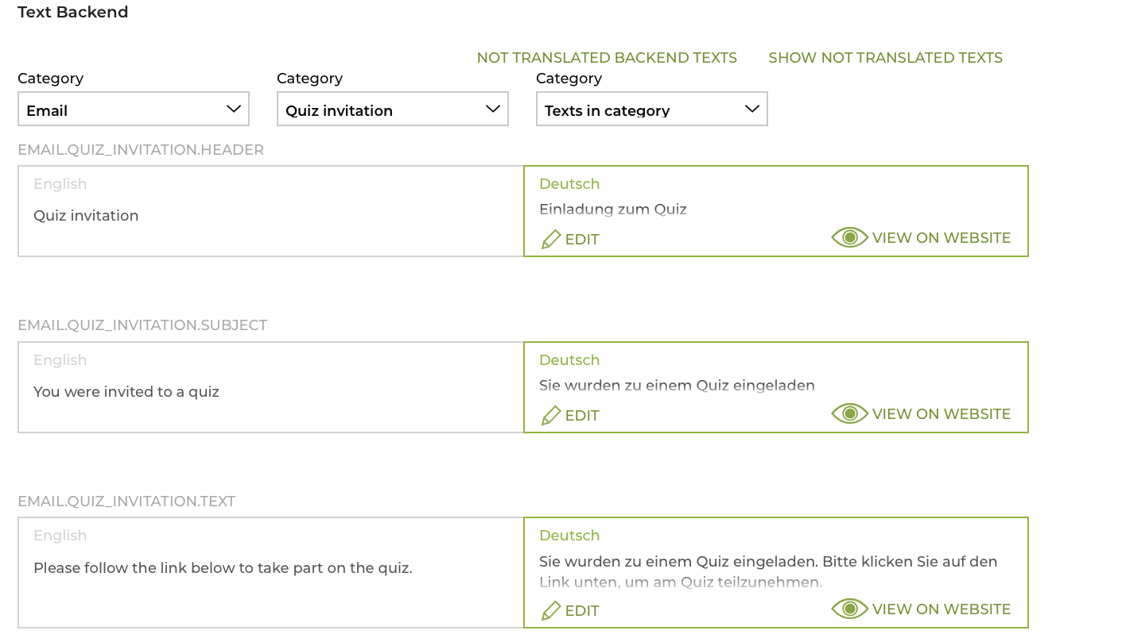
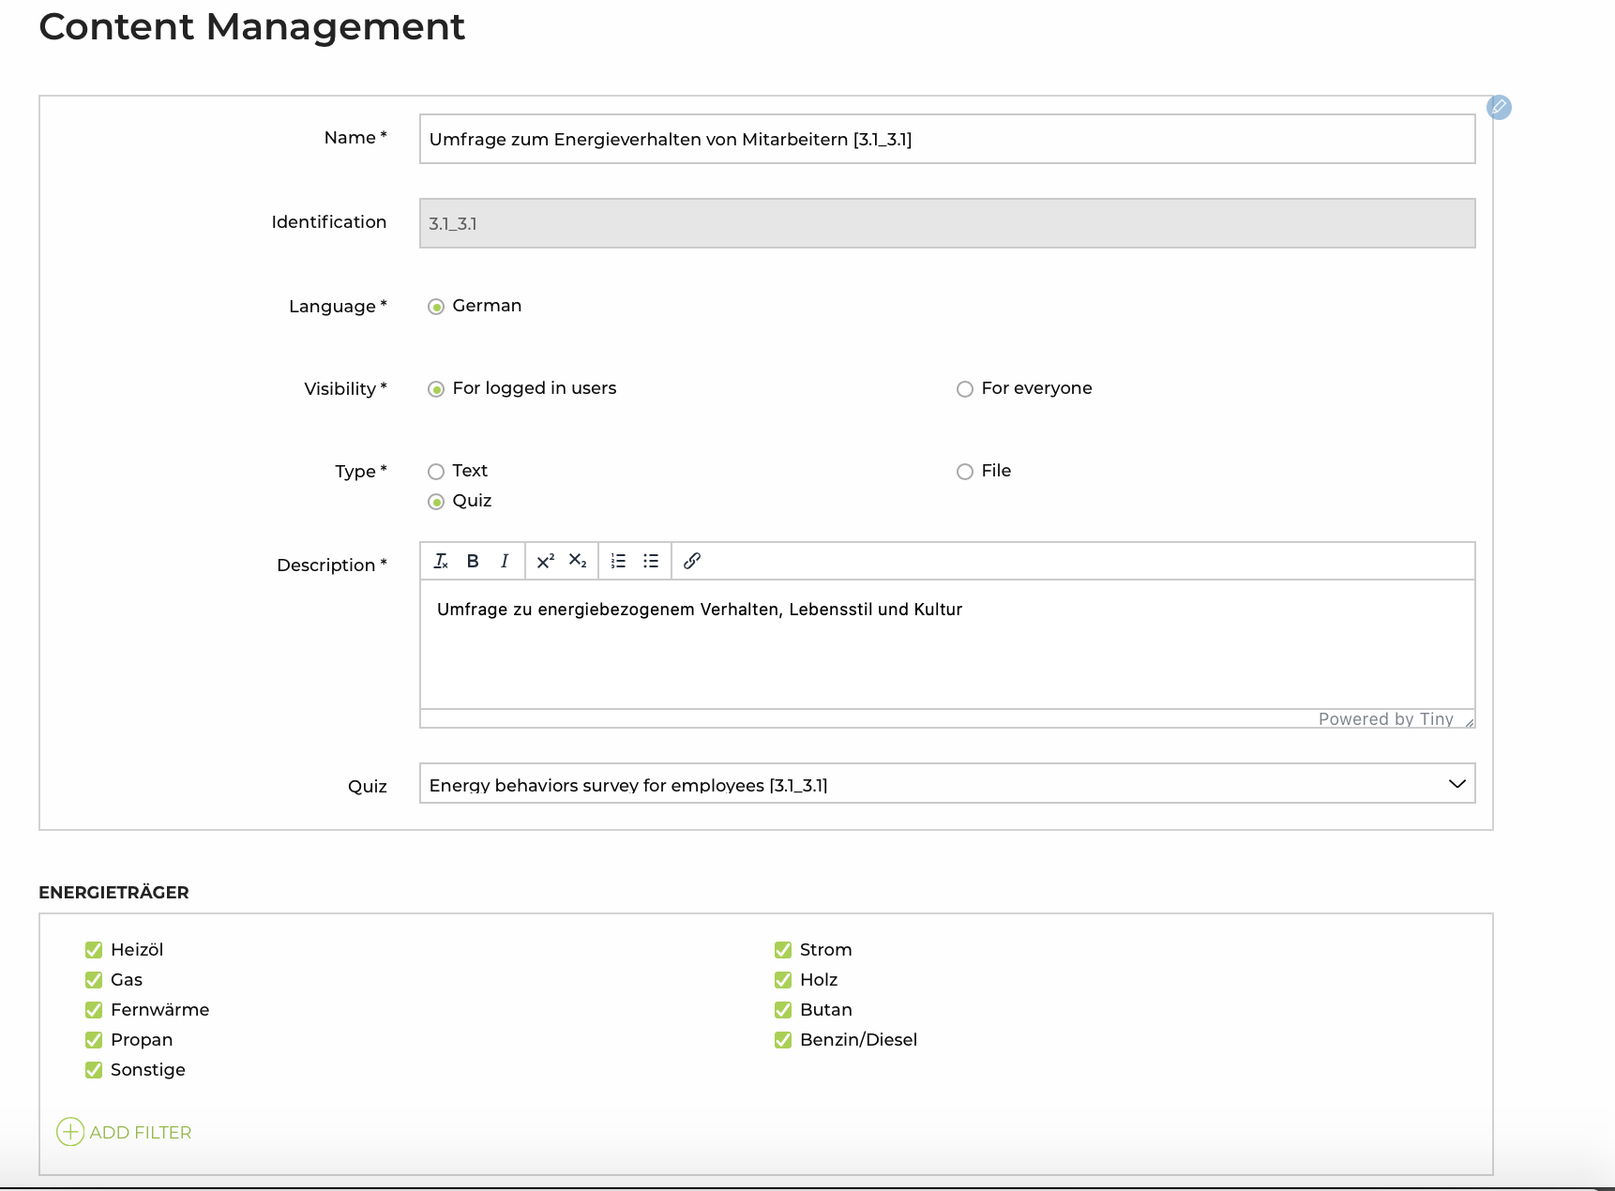
Text and Content Management and Administration
Text backend is easy to be translated following the navigation structure including quick view option
Content elements are uploaded on the platform and tagged according to filter criteria

Slide 29

Energy Efficiency Information available on the Platform
Konstantin Kulterer
Austrian Energy Agency
AUSTRIA

Slide 30
Energy efficiency Information & Energy management
13 technological areas plus energy management
Energymanagement Lighting Office Hydraulic and Isolation of Pipes Heating of buildinds and –envelope Cooling Compressed Air | Fans Pumps Steam Industrial heating Heatpumps and Heat Recovery Renewable Energy Mobility
Notes:
One focus of the Impawatt platform is information on energy efficiency. Information on the following technologies is available for you. Energy management, lighting, office, hydraulic and pipe insulation, Heating of buildinds and –envelope, cooling, compressed air, fans, pumps, steam, industrial ovens, heat pumps and heat recovery, renewable energies and mobility.

Slide 31
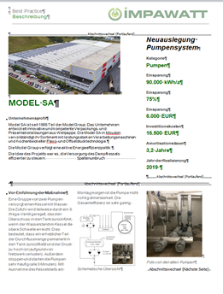
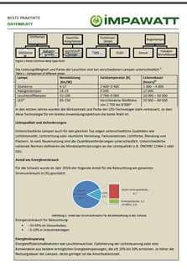
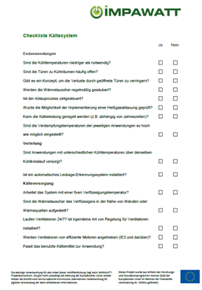
Efficiency information - Impawatt Platform
  Powerpoint presentation
  Description of savings measures
  Checklists and datacollection sheets
  Best cases
  Knowledge quiz
Notes:
The following documents were developed for each of the 12 efficiency topics: open Powerpoint presentations, descriptions of measures, checklists and data collection sheets, and 40 case studies. You will also find quizzes to check your own knowledge or that of your employees. You can use this information for internal workshops or for your own advanced training. In the following, I would like to use the example of mobility to show where you can find the documents and what information they contain.

Slide 32
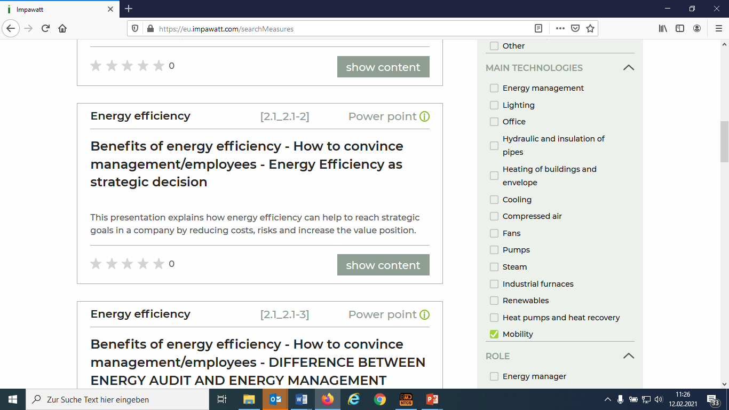
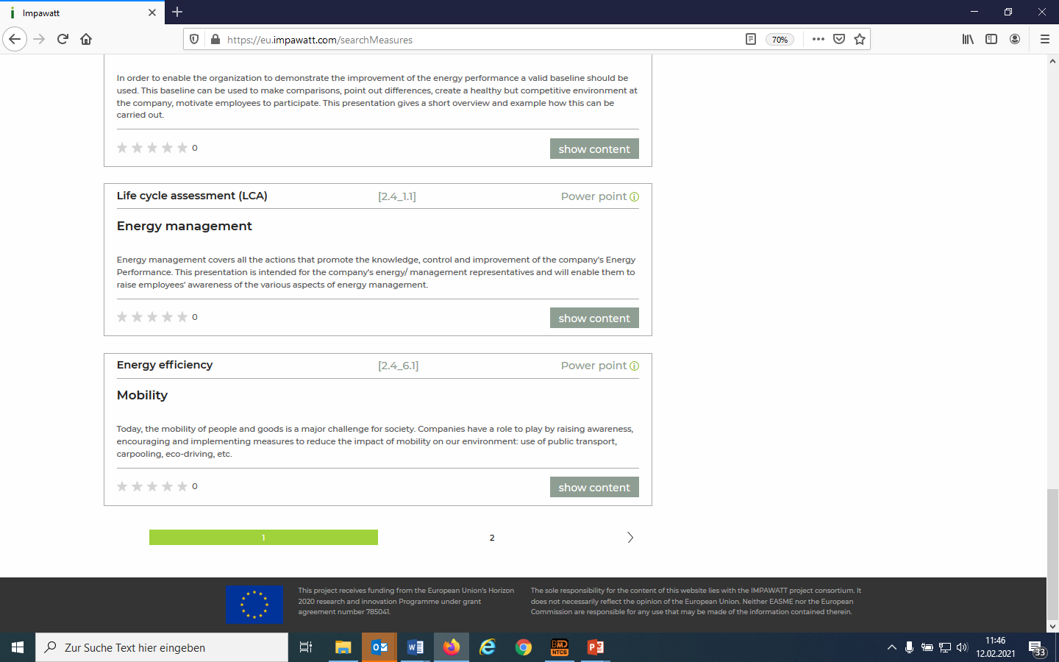
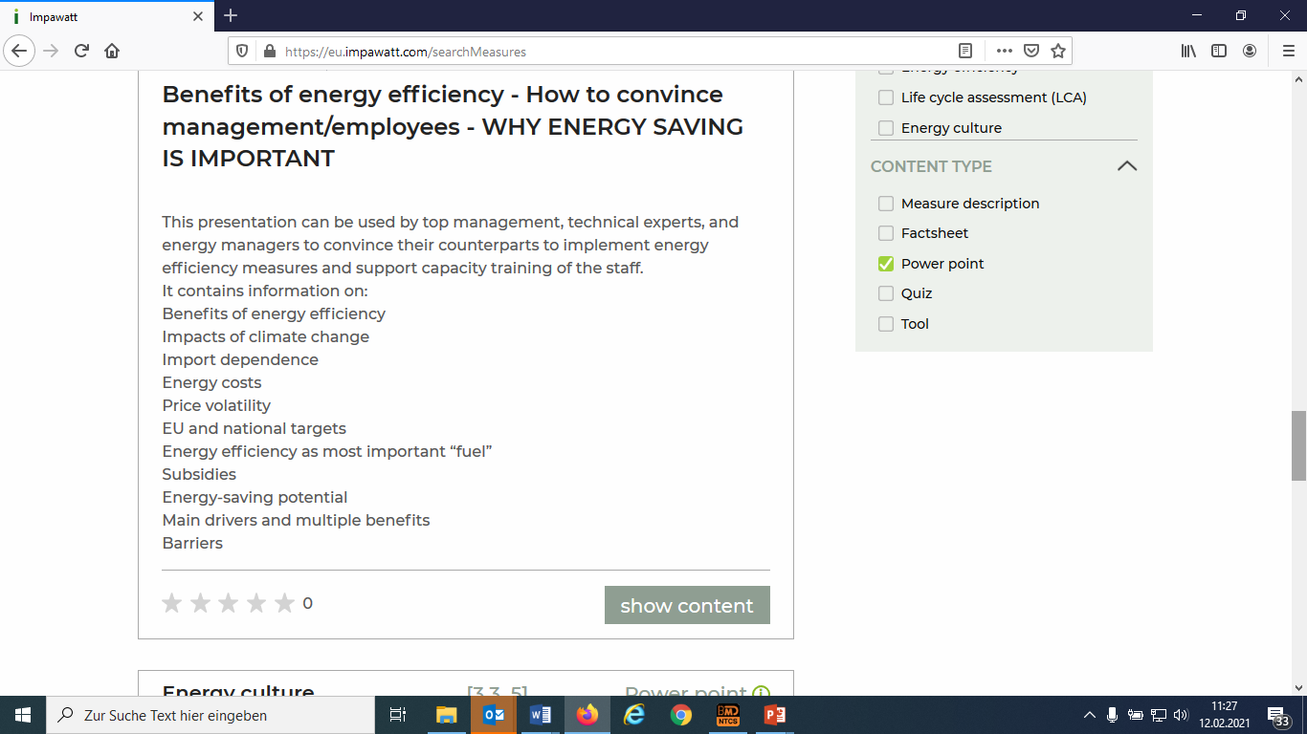
Presentation
Filter:
Main Technologies – Mobility
Content type: Power point
Notes:
First to the presentations on the 13 technologies. You can find them, for the example of mobility, with the following filter settings: Main technologies Mobility, Type: Presentation

Slide 33
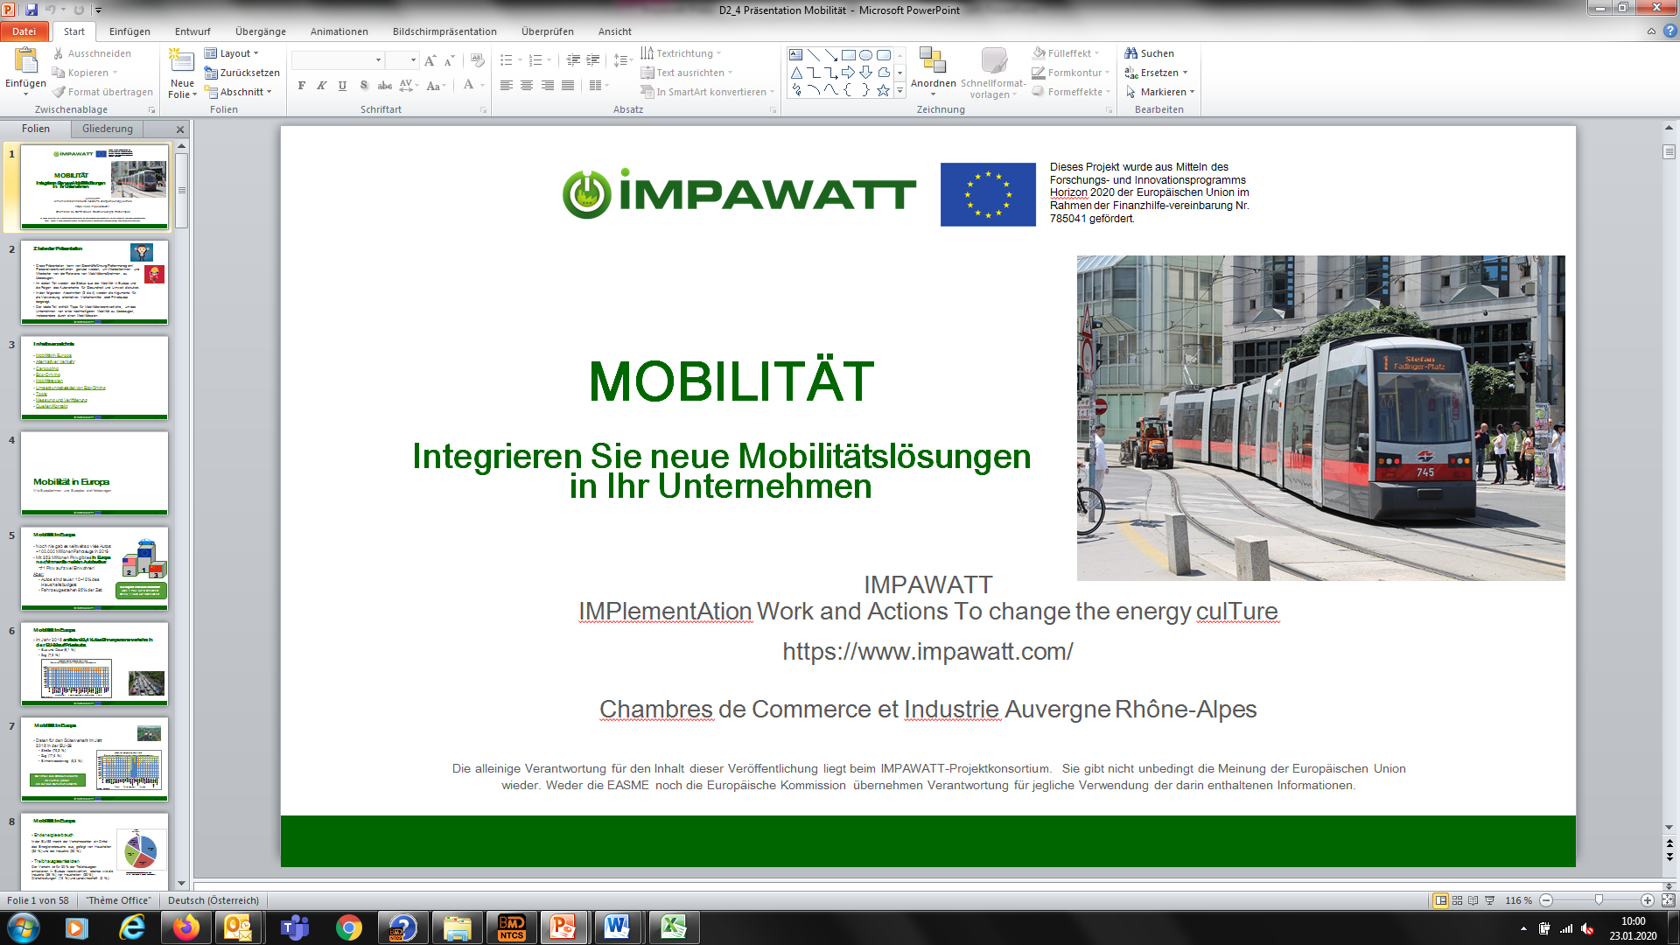
Presentation
General introduction to each topic
Measure description
Best Cases
Measure & Verification
Approx. 40 Slides
„White label“ presentation, open ppt
Notes:
Each presentation contains the following content: General introduction to the topic, descriptions of measures to improve energy efficiency and case studies. Furthermore, brief information on measuring and verifying savings measures in the respective system. The scope of the presentations is approx. 40-60 slides. You can edit the slides for the respective context.

Slide 34
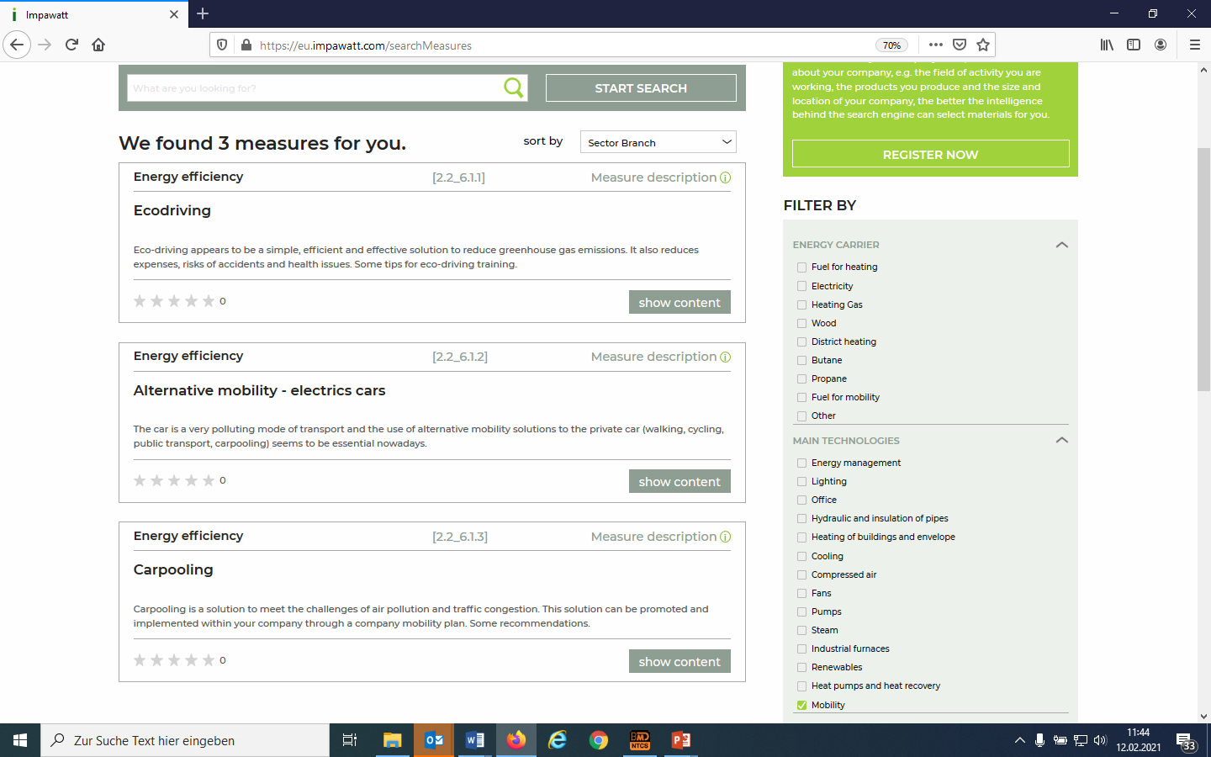
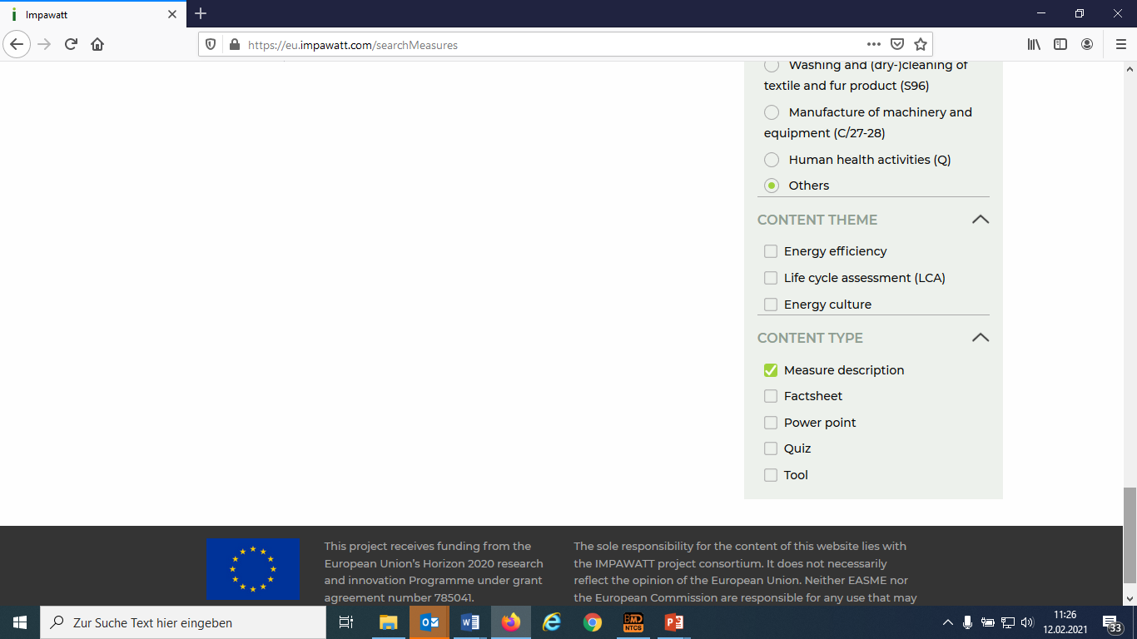
Measure Description
Filter:
Main Technologies – Mobility
Content typ:
Measure Description
Notes:
Another content of the platform are presentations.
For mobility, set the filter for main technologies to mobility, under the type select description of measures. There are currently 3 measures for this:
Ecodriving, Alternative mobility – electric cars, carpooling.

Slide 35
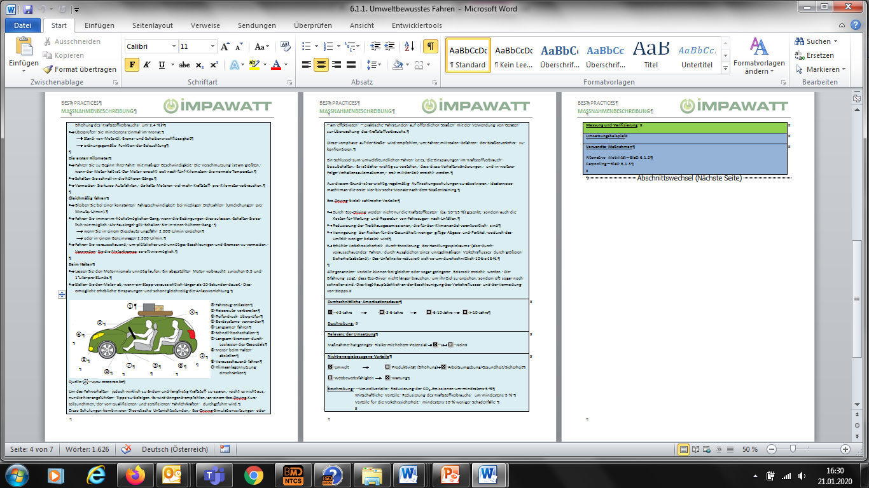
Measure Description
Description of technology
Energy efficiency measure:
  Description /Initial situation,
  Recommendation for implementation
Further information: Average paybacktime, Measurement &Verification, examples for implementation
Overall 70 measures
Ex of measure:
Ecodriving
Notes:
What information can you find in the description of measures? First, an overview of the individual technology areas. You will then see a description of the efficiency measure. In addition, Impawatt includes information on the amortization period, measurement and verification and, in some cases, implementation examples. In total, descriptions of 70 measures are available.

Slide 36
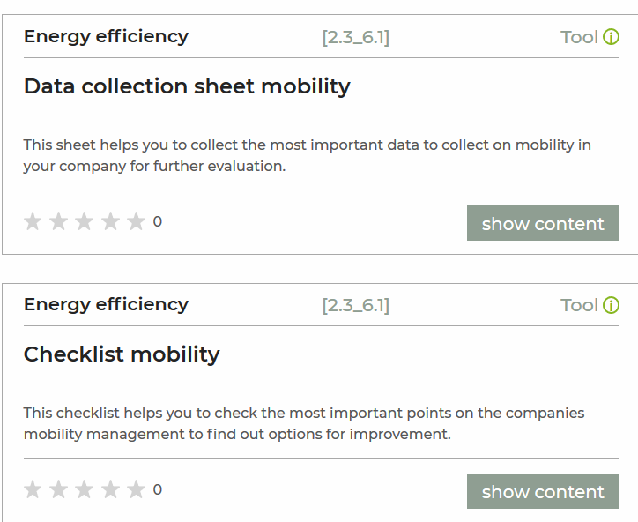
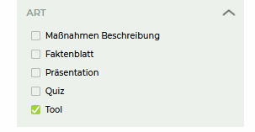
Tools – Checklist, Data Collection Sheet
Filter:
Main Technologies – Mobility
Content type: Tool
Notes:
We come to the next point: tools or. Data entry sheets and checklists: Again, you can first select the technology and then click the type, in this case, tool.

Slide 37
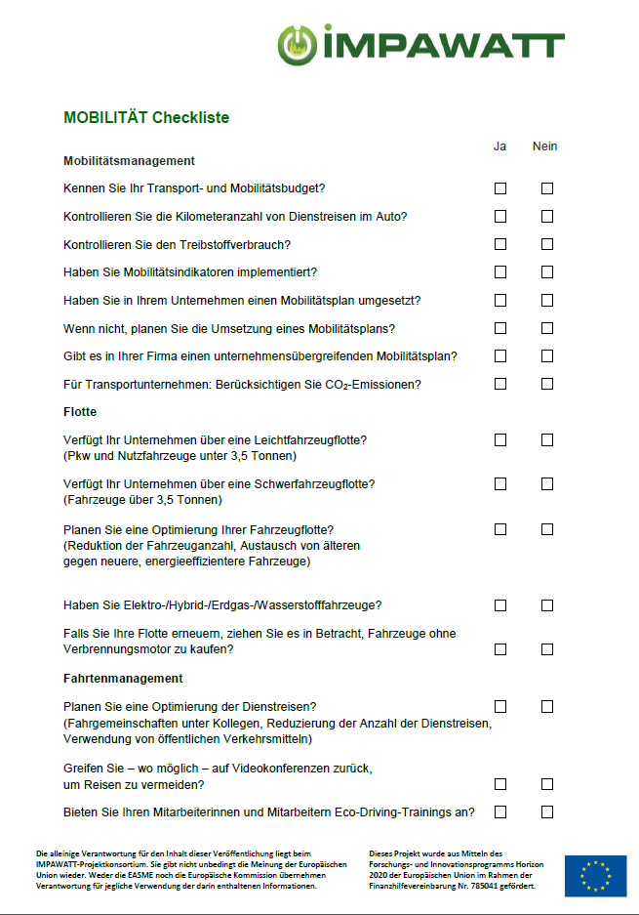
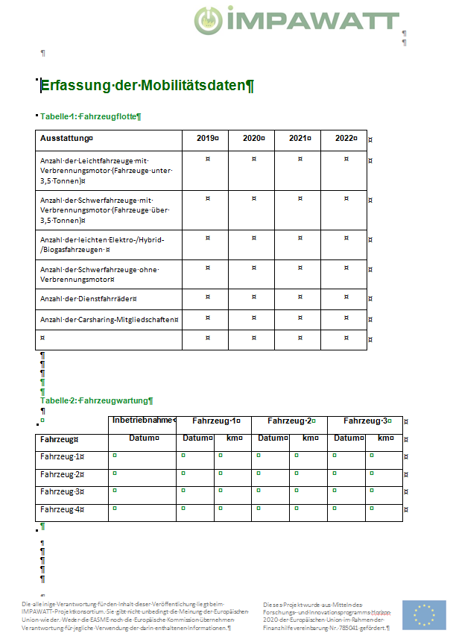
Checklist, Data Collection Sheet
Checklist for on-site walk throughs
Datacollection sheet for further evaluation of saving measure
Notes:
In the checklist, you will find questions for the different technologies for the on-site inspection, such as: Do you have the key figures? Do you know the CO2 emissions? Do you use video conferences? Etc. The data entry sheet shows tables for the data, eg number and type of vehicles, mileage, which help you to collect relevant data during inspection.

Slide 38
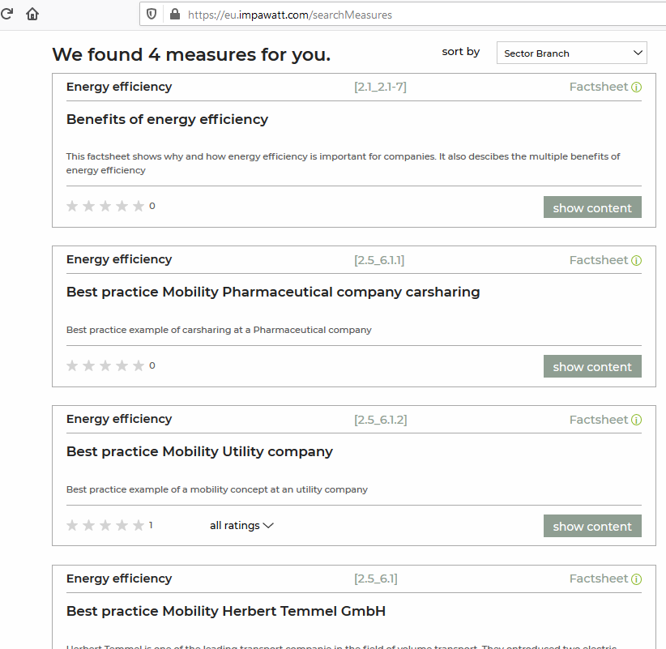
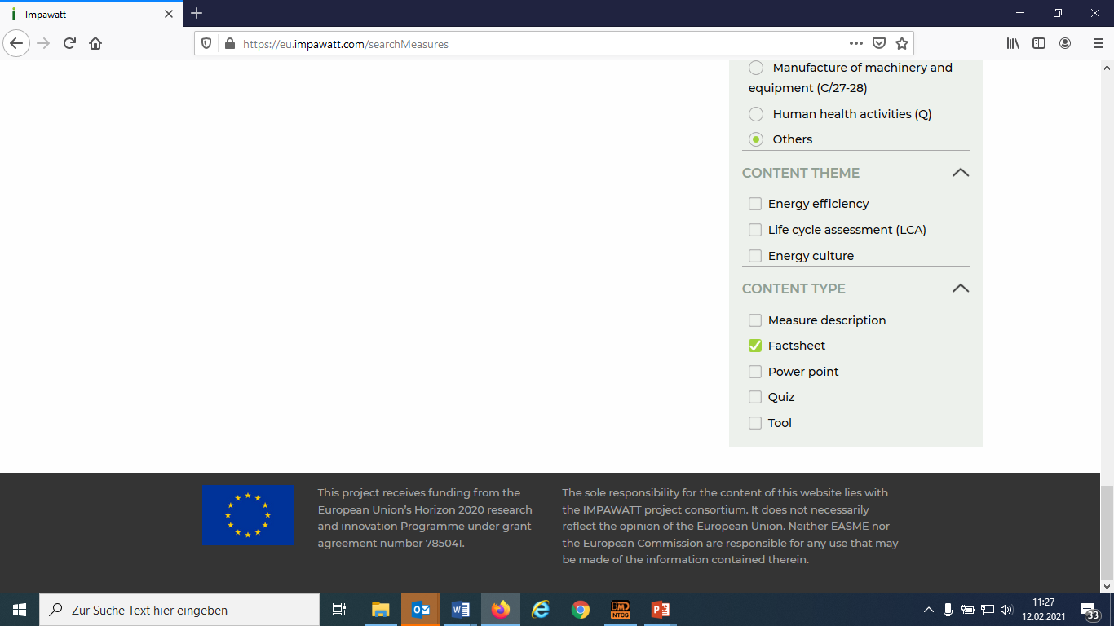
Case Studies/Best Practice
Main Technologies – Mobility
Content type :
Fact Sheet
Notes:
Now for the case studies. You tick the box next to the main technologies mobility, but this time you choose the fact sheet as the document type. You will find a total of four case studies in the mobility area.

Slide 39
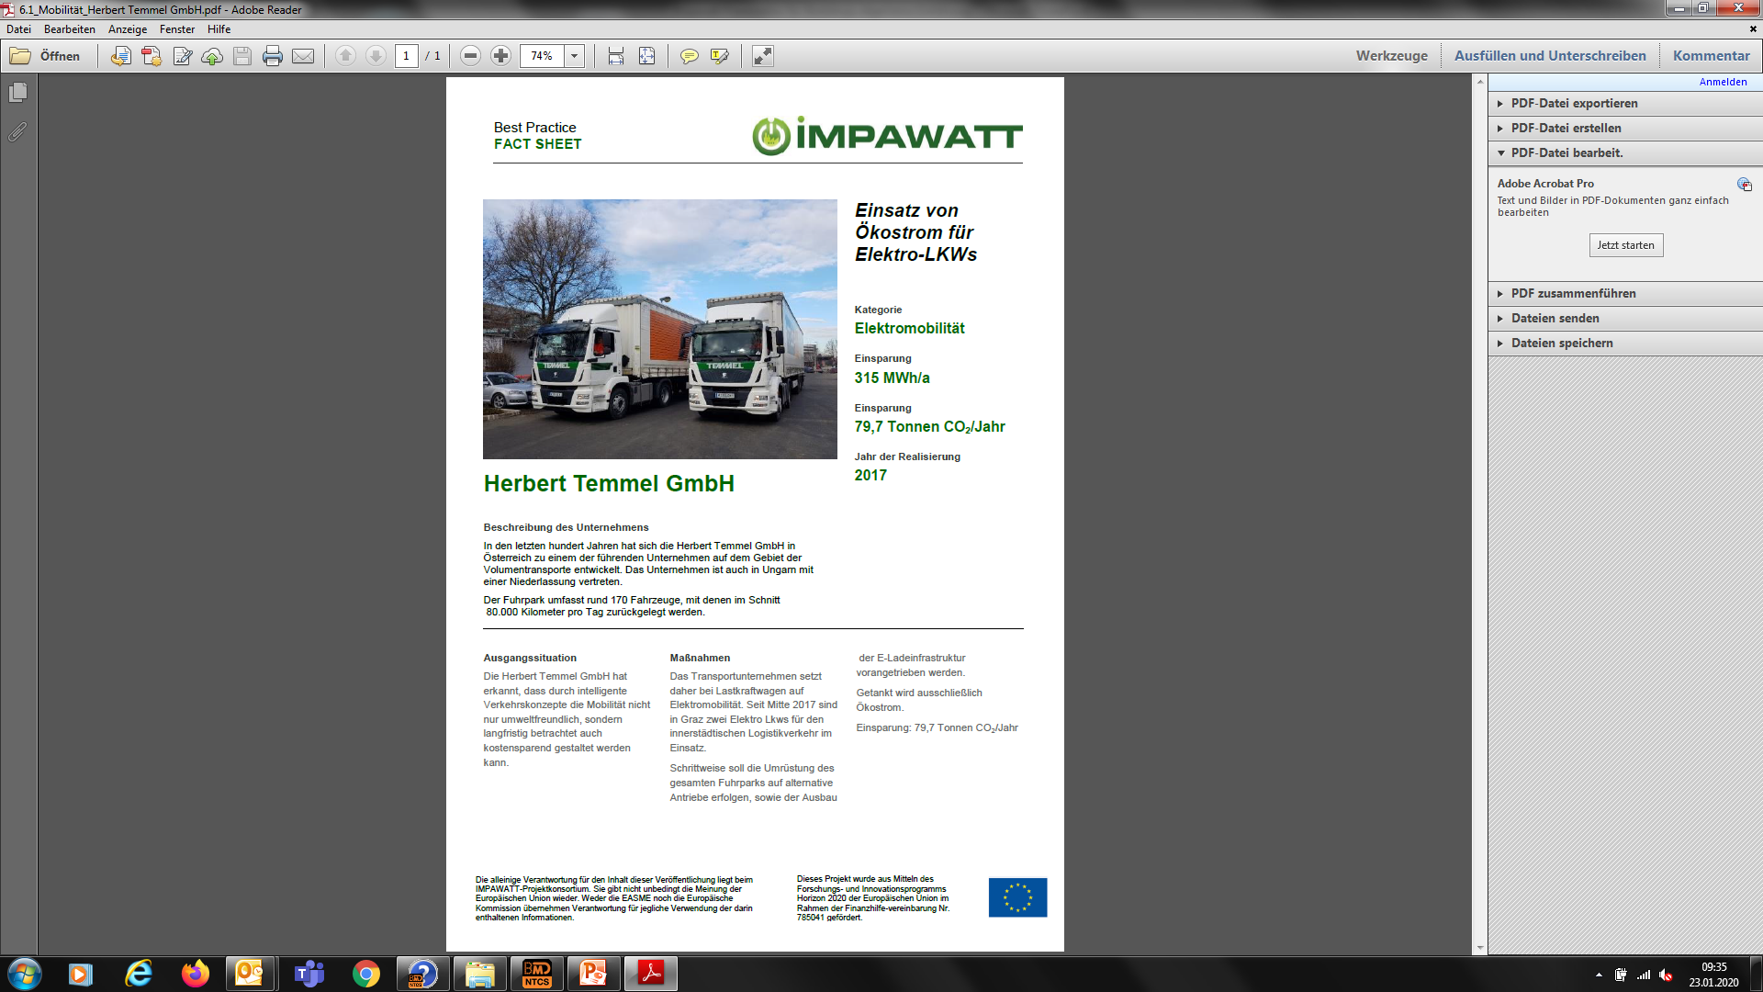
Best Practice
Description of company
Initial situation, description of measure
Saving: Energy, CO2
Information on economics
(investment costs, payback time) if available
Year of implementation
40 best practice examples covering all technological areas
Notes:
What does the description of a best practice contain? First a brief description of the company, then the initial situation and the description of the measures. You will also find information on energy and CO2 savings Furthermore information on profitability (savings in EUR, investment costs) if available or released for publication.

Slide 40
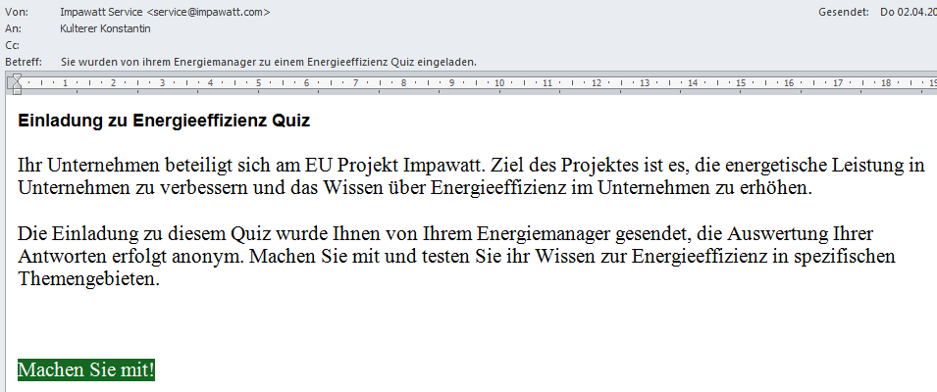
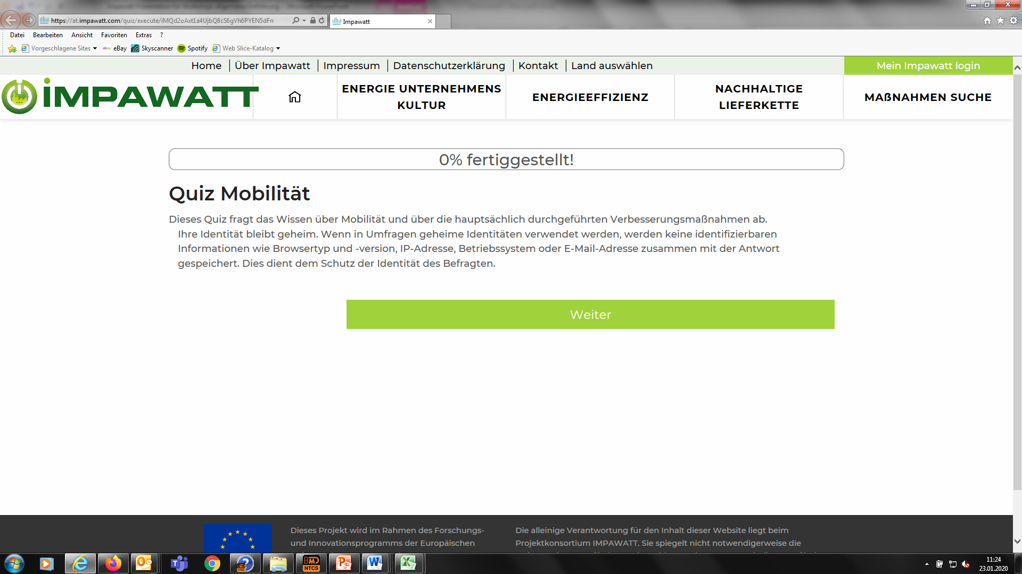
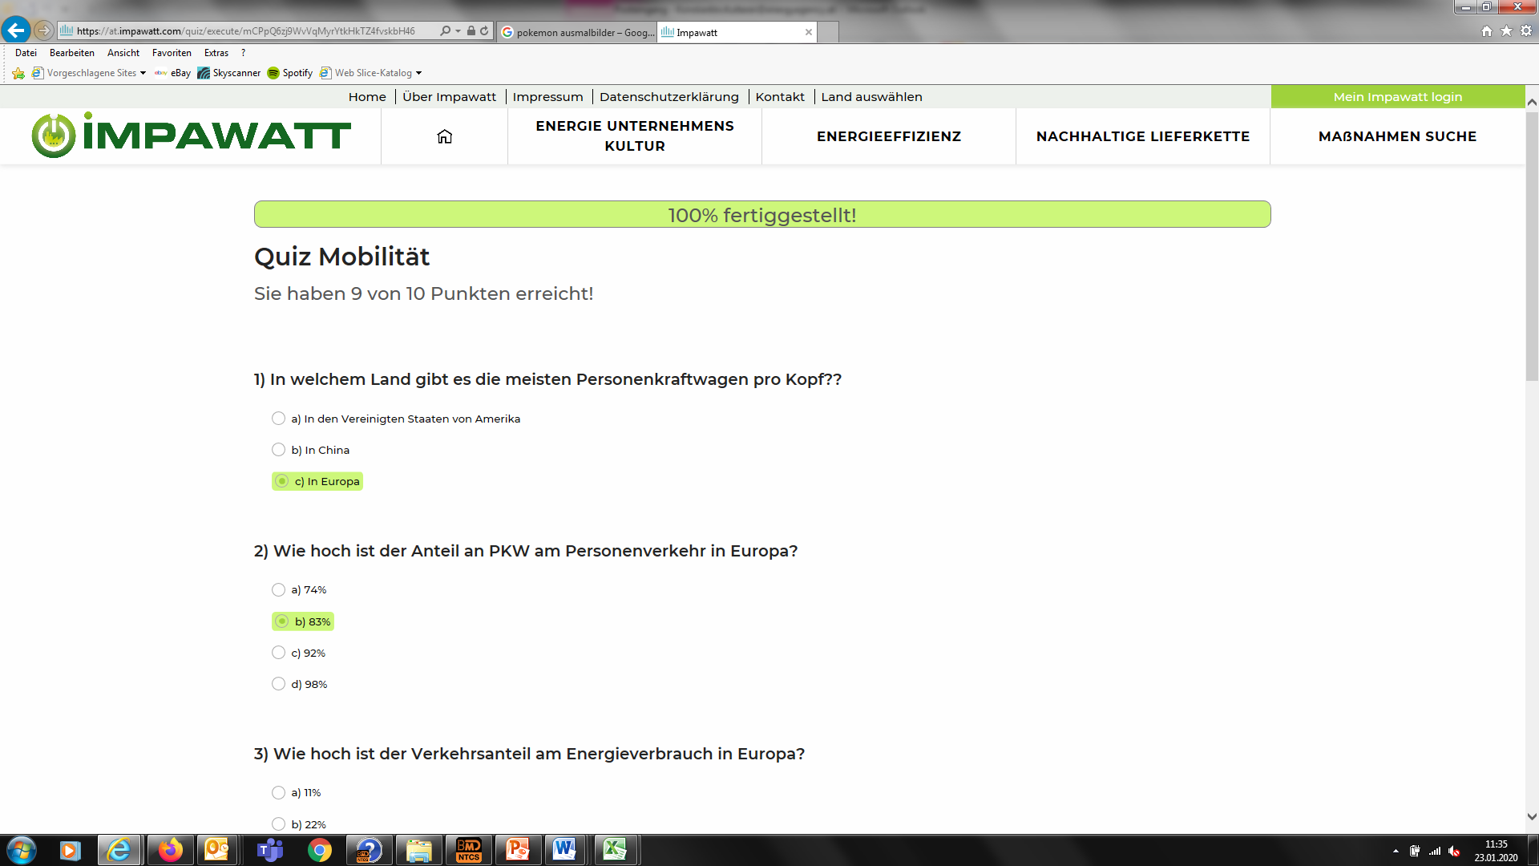
Quiz View of Employees
Invited Employees get email with invitation and start directly without registration the quiz. At the end, they get the result and for each question their answer and the correct answer
Notes:
You will find that Impawatt offers a quiz for every technology as well as for the topics of energy management and sustainable supply chain. The quiz relates to information from the presentation and serves to check your knowledge.
It can be sent to email addresses via the platform.
Invited Employees get email with invitation and start directly without registration the quiz. At the end, they get the result and for each question their answer and the correct answer

Slide 41
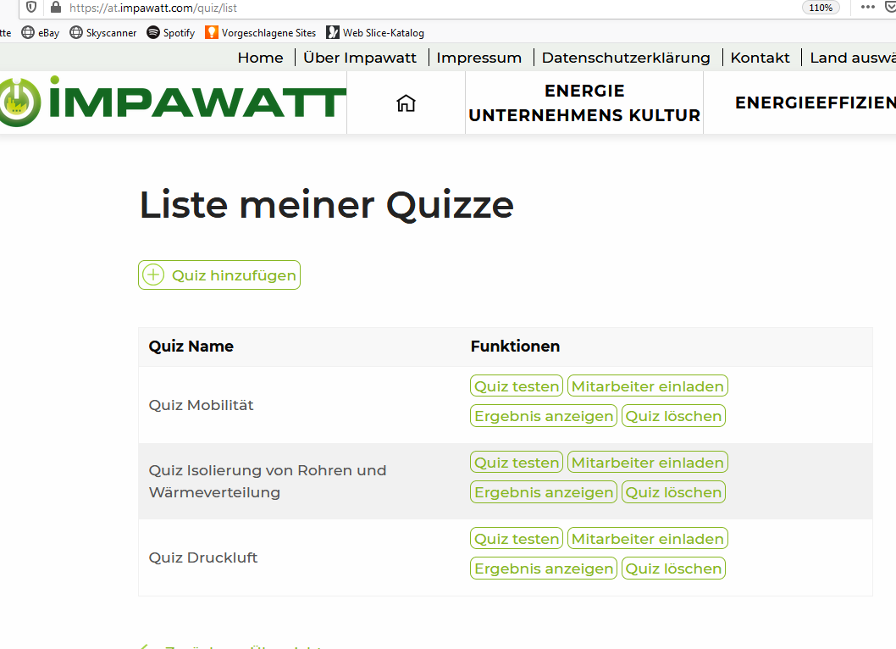
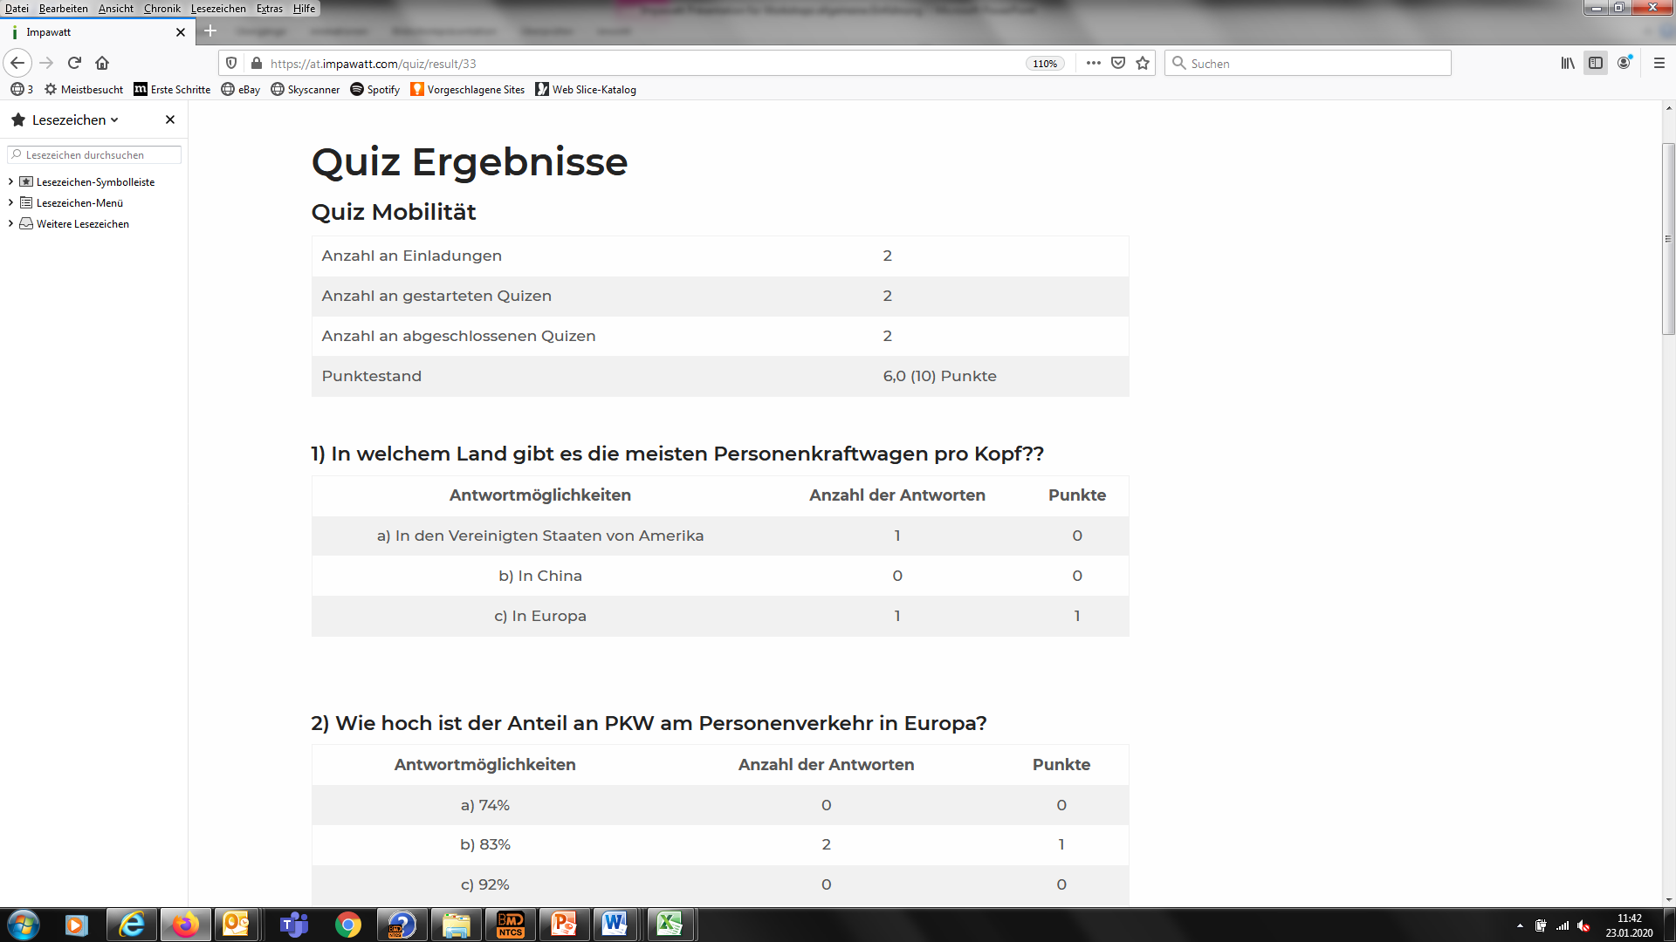
View of Energiemanager
Results for the energymanager: Number of started and finalized quizzes, average points per participant, for each question results of all participants (anonymized!)
List of my quizzes energymanager can see the total results
Notes:
On this slide you can see how the energy manager can view the results. The energy manager can click the Show results button in the list of my quizzes.
The energy manager automatically receives the evaluation and presentation of the results at the end.
As result he gets: Number of started and finalized quizzes, average points per participant, for each question the results of all participants (therefore it is anonymized!)
We recommend you to use the results as a basis for further training of yourself and of your staff.

Slide 42
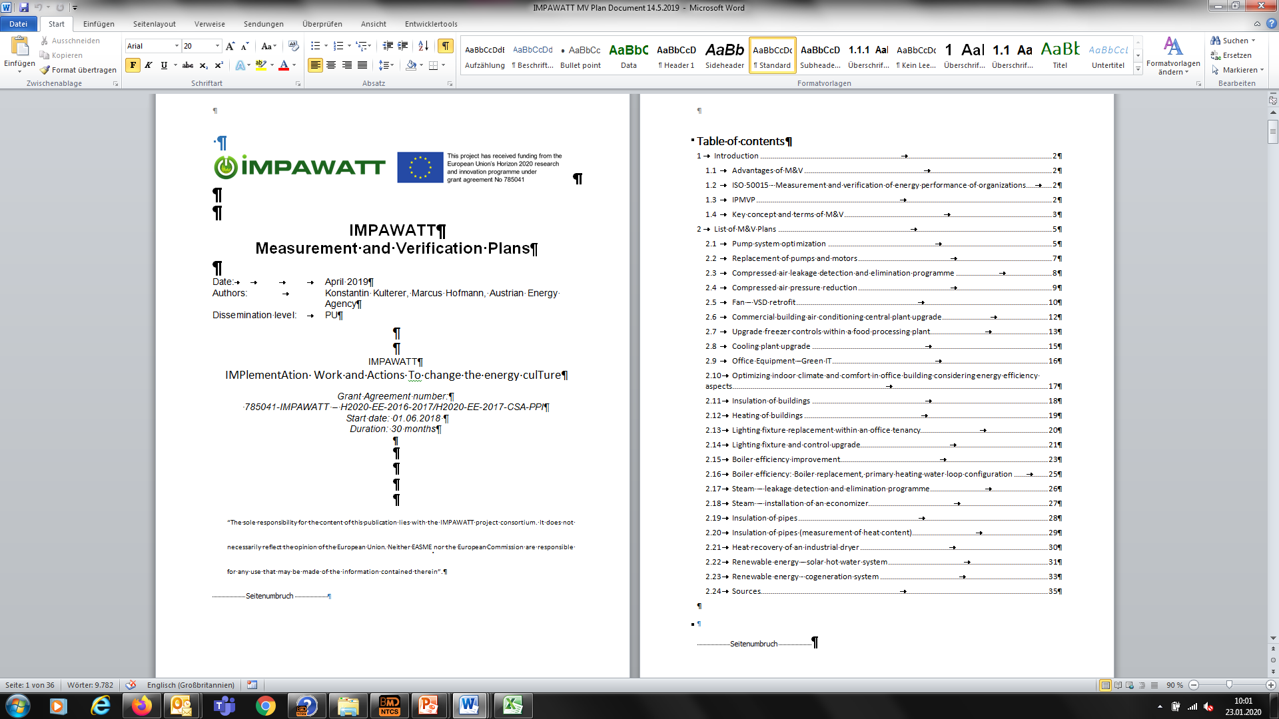
Further informationen on the platform
Motivation of employees, and how to convince top-management
Information for financing instruments/subsidies
24 Measure and Verificationplans for all technologies with details to paramters to be measured for verification of energy savings (English only)
Notes:
Further materials on the platform can be found: Presentations to convince management and employees A short presentation on funding opportunities And: 24 measurement and verification plans for all technologies with details on parameters, such as how long which parameter is to be measured. This material is only available in English.

Slide 43

Energy culture - An assessment method for SMEs
Zarrin Fatima, Francesco Reda

Slide 44
Energy culture
What do we mean by this term?
Energy culture combines behavioural, technical and cultural perspectives
Why do we need to assess it?
Energy management performed in larger companies
SMEs are the driving force of manufacturing economies - Representing about 90% of businesses and more than 50% of employment worldwide
Yet they face challenges in addressing energy concerns
Need for a continuous, easy, no cost monitoring method

Slide 45
Energy culture - What we did?
Identifying an ’Energy Manager’ (someone who manages both external and internal tasks)
A dedicated short survey for Employees – to understand their daily choices, work habits and preferences
A dedicated short survey for Energy Managers – to understand their responsibilities, some technical information

Slide 46
Energy culture - How we did it?
Maturity matrix calculates and provides a score based on Five Pillars → Each answer in the survey has been given a score
User is provided with recommendations based on the score
The survey can be completed as many times needed to improve energy efficiency within the SME and improve the Employees & Energy Manager’s knowledge and awareness

Slide 47
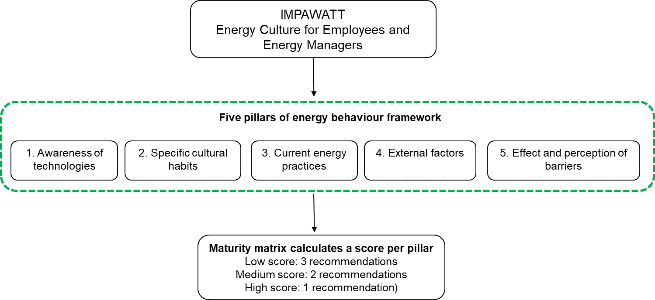

Slide 48
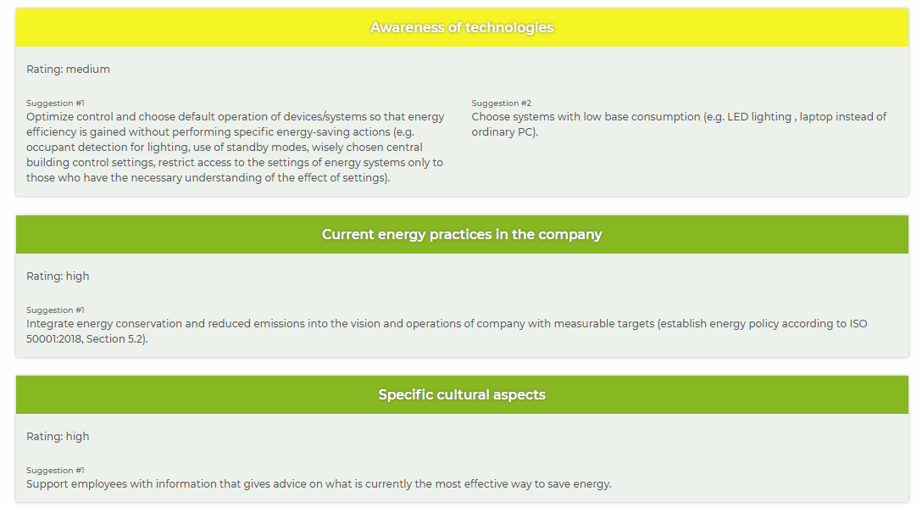
Employee survey example

Slide 49
Employee recommendations planning timeline

Slide 50
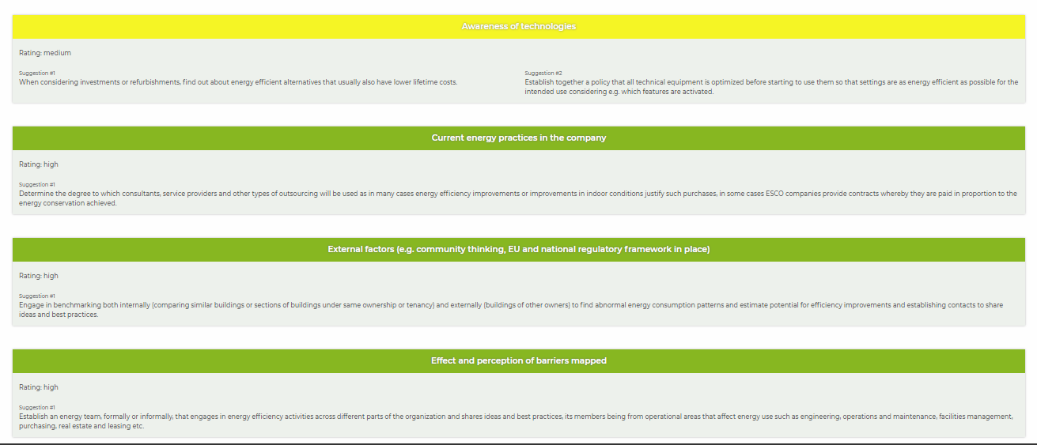
Energy manager survey example

Slide 51
Energy manager recommendations timeline

Slide 52
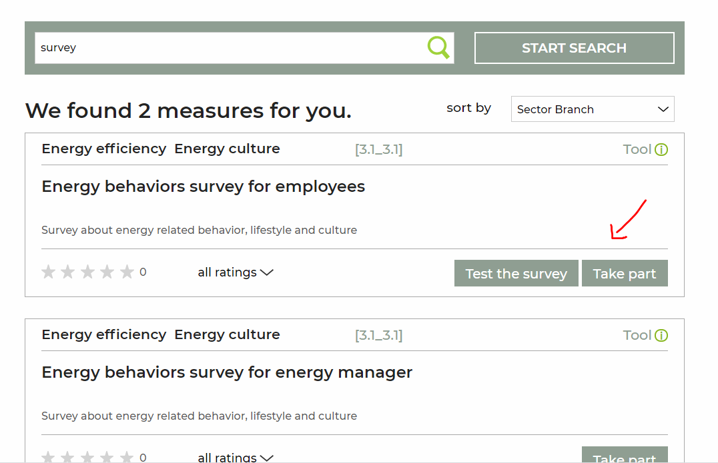
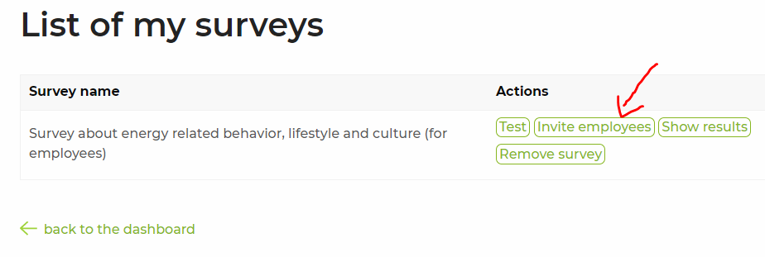
How to find the survey for Employees (invite yourself or your staff)

Slide 53
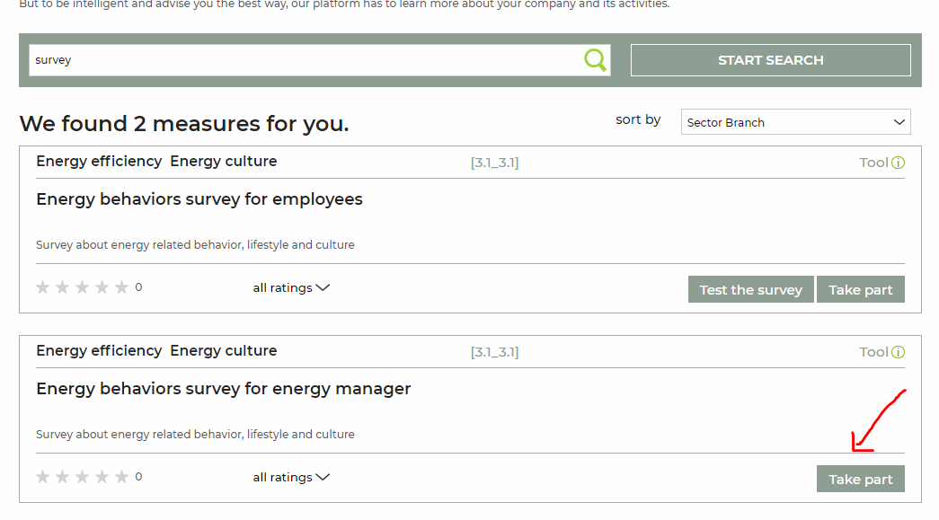

How to find the survey for Energy Managers (no need for inviting)

Slide 54
Tool for greenhouse emission
Sirje Vares

Slide 55
Background
IMPAWATT tool calculates the greenhouse gas emissions (GHG) from the energy use in user defined manufacturing / assembly / production systems
Assessment considers GHG emissions caused by combustion and pre-combustion because of the acquisition of fuels.
The method considers also the embodied emissions of renewable energy technologies.
Tool enables to compare your ‘current case’ with the possible savings, as ‘what if’ cases:
    the savings could be based on improved energy-efficiency,
    because of shifting to lower carbon fuels or
    Because taking use of renewable energy carriers.

Slide 56

Simple as possible: give Input and get output (GWP value)
Fill required input - all energy flows and fuels that enter to your process.
Choose country for the electricity production method
Give unit emission for your district heat case
Get Global warming potential value as an output for your defined system product / services.
Output is a GWP fossil value (main emissions included are CO₂, CH₄, N₂O …).
INPUTS
INPUTS
INPUTS
YOUR PROCESS
OUTPUTS

Slide 57

Overview of the project activities made with the companies to overcome barriers
Luca Galeasso
ITALY

Slide 58
At the beginning of IMPAWATT… the barriers to energy efficiency
Which barriers the companies identify in the implementation of energy efficiency measures?
INTERNAL barriers
  Economic (economic/financial capacity, additional risks, …)
  Non economic (organizational and behavioural aspects)
EXTERNAL barriers (supply chain, availability of technologies, difficulties to access incentives)

Slide 59


At the beginning of IMPAWATT… the barriers to energy efficiency
Some results of the analysis… Approach to energy management

Slide 60


At the beginning of IMPAWATT… the barriers to energy efficiency
Some results of the analysis… Approach to the energy management

Slide 61

At the beginning of IMPAWATT… the barriers to energy efficiency
Some results of the analysis… Which barriers to the implementation of measures?

Slide 62
The IMPAWATT «integrated» approach to barriers
THE ENERGY EFFICIENCY PROCESS
TOOLS TO IMPROVE ENERGY CULTURE
PRACTICAL TOOLS FOR ENERGY ANALYSIS
DOCUMENTATION ON THE IMPORTANCE OF ENERGY EFFICIENCY
IMPAWATT PLATFORM
EXAMPLES and SUCCESS STORIES
INFO on AVAILABLE TECHNOLOGIES
ENERGY DASHBOARD

Slide 63
The IMPAWATT actions
Closing the loop… how IMPAWATT actions and results will support your energy efficiency projects?
 | Economic internal barriers | Low sensitivity and awareness level | Lack of competences | Staff attitude and behaviour | Information sources and evaluation criteria | Technologies unknown | Complexity in application of measures | Difficulties to access incentives
Docs on the importance of energy efficiency
Tools to improve energy culture
Practical tools for energy analysis
Examples and success stories
Info on available technologies
Energy dashboard

Slide 64

How to find the tool

Slide 65
IMPACTS and discussion
IMPlementAtion Work and Actions To change the energy culTure
The sole responsibility for the content of this publication lies with the IMPAWATT project consortium. It does not necessarily reflect the opinion of the European Union. Neither EASME nor the European Commission are responsible for any use that may be made of the information contained therein.

Slide 66

MAIN IMPACTS (current status, ongoing)
More than
150 users made an account on the IMPAWATT platform.
110 energy efficiency measures were found through the program (energy check-ups or workshops).
900 people have a higher knwoledge on energy efficiency and culture.
55 webinars

Slide 67

Open discussion
What are the strengths and weaknesses of the Impawatt? Can it contribute to better energy awareness and implementation of energy measures in an SME?
Who will be the most willing to register to this platform.
Menti : https://www.menti.com/i7uo4baiii

Slide 68

Our solution
THANK YOU FOR
YOUR ATTENTION
IMPlementAtion Work and Actions To change the energy culTure

